Slide 1
Thermal Chemical Convection Coupled model for magma dynamics Velocity-Pressure Coupling
Mingming Zhang
2020-7-13
Cartesian coordinates
Identical to MAGTC3 except crystal motion

Slide 2
$$x, j$$
$$∆x_{j−1}$$
$$∆x_{j}$$
$$∆x_{j+1}$$
$$y,k$$
$$T_{j,k−1}$$
$$∆y_{k−1}$$
$$vy_{j,k−0.5}$$
$$T_{j−1,k}$$
$$T_{j,k}$$
$$T_{j+1,k}$$
$$vx_{j−0.5,k}$$
$$∆y_{k}$$
$$vx_{j+0.5,k}$$
$$vy_{j,k+0.5}$$
$$T_{j,k+1}$$
$$∆y_{k+1}$$

Slide 3
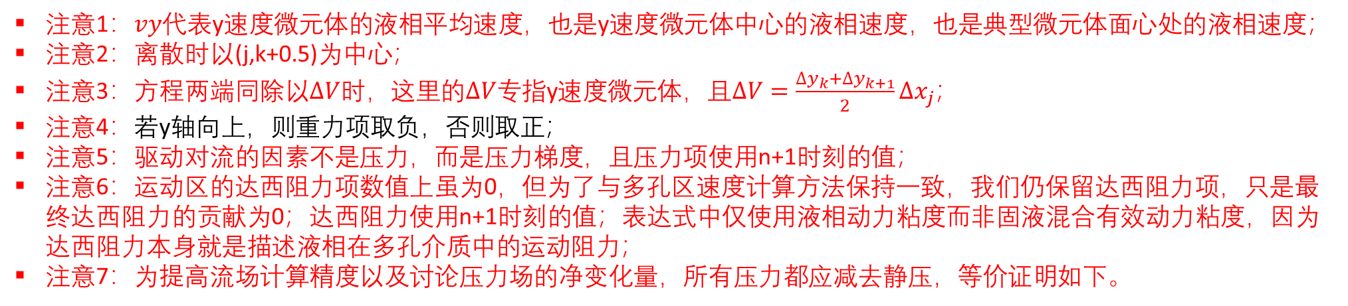
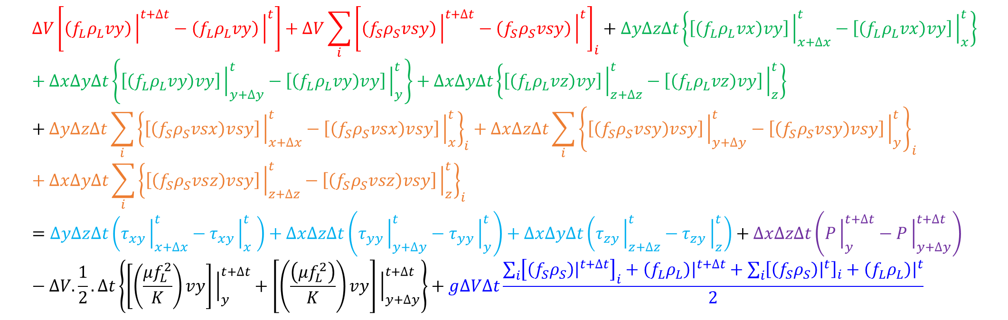
动量守恒方程（运动区-Y）
Y方向动量守恒方程：
$$∆V\left[\left(f_{L}ρ_{L}vy\right){\left.​\right|}^{t+∆t}−\left(f_{L}ρ_{L}vy\right){\left.​\right|}^{t}\right]+∆V\sum_{i}{{\left[\left(f_{S}ρ_{S}vsy\right){\left.​\right|}^{t+∆t}−\left(f_{S}ρ_{S}vsy\right){\left.​\right|}^{t}\right]}_{i}}+∆y∆z∆t\left\{\left[\left(f_{L}ρ_{L}vx\right)vy\right]{\left.​\right|}_{x+∆x}^{t}−\left[\left(f_{L}ρ_{L}vx\right)vy\right]{\left.​\right|}_{x}^{t}\right\}+∆x∆y∆t\left\{\left[\left(f_{L}ρ_{L}vy\right)vy\right]{\left.​\right|}_{y+∆y}^{t}−\left[\left(f_{L}ρ_{L}vy\right)vy\right]{\left.​\right|}_{y}^{t}\right\}+∆x∆y∆t\left\{\left[\left(f_{L}ρ_{L}vz\right)vy\right]{\left.​\right|}_{z+∆z}^{t}−\left[\left(f_{L}ρ_{L}vz\right)vy\right]{\left.​\right|}_{z}^{t}\right\}+∆y∆z∆t\sum_{i}{{\left\{\left[\left(f_{S}ρ_{S}vsx\right)vsy\right]{\left.​\right|}_{x+∆x}^{t}−\left[\left(f_{S}ρ_{S}vsx\right)vsy\right]{\left.​\right|}_{x}^{t}\right\}}_{i}}+∆x∆z∆t\sum_{i}{{\left\{\left[\left(f_{S}ρ_{S}vsy\right)vsy\right]{\left.​\right|}_{y+∆y}^{t}−\left[\left(f_{S}ρ_{S}vsy\right)vsy\right]{\left.​\right|}_{y}^{t}\right\}}_{i}}+∆x∆y∆t\sum_{i}{{\left\{\left[\left(f_{S}ρ_{S}vsz\right)vsy\right]{\left.​\right|}_{z+∆z}^{t}−\left[\left(f_{S}ρ_{S}vsz\right)vsy\right]{\left.​\right|}_{z}^{t}\right\}}_{i}}=∆y∆z∆t\left(τ_{xy}{\left.​\right|}_{x+∆x}^{t}−τ_{xy}{\left.​\right|}_{x}^{t} \right)+∆x∆z∆t\left(τ_{yy}{\left.​\right|}_{y+∆y}^{t}−τ_{yy}{\left.​\right|}_{y}^{t}\right)+∆x∆y∆t\left(τ_{zy}{\left.​\right|}_{z+∆z}^{t}−τ_{zy}{\left.​\right|}_{z}^{t}\right)+∆x∆z∆t\left(P{\left.​\right|}_{y}^{t+∆t}−P{\left.​\right|}_{y+∆y}^{t+∆t}\right)−∆V.\frac{1}{2}.∆t\left\{\left[\left(\frac{μf_{L}^{2}}{K}\right)vy\right]{\left.​\right|}_{y}^{t+∆t}+\left[\left(\frac{\left(μf_{L}^{2}\right)}{K}\right)vy\right]{\left.​\right|}_{y+∆y}^{t+∆t}\right\}+g∆V∆t\frac{\sum_{i}{{\left[\left(f_{S}ρ_{S}\right){\left.​\right|}^{t+∆t}\right]}_{i}}+\left(f_{L}ρ_{L}\right){\left.​\right|}^{t+∆t}+\sum_{i}{{\left[\left(f_{S}ρ_{S}\right){\left.​\right|}^{t}\right]}_{i}}+\left(f_{L}ρ_{L}\right){\left.​\right|}^{t}}{2}$$
注意1：$vy$代表y速度微元体的液相平均速度，也是y速度微元体中心的液相速度，也是典型微元体面心处的液相速度；
注意2：离散时以(j,k+0.5)为中心；
注意3：方程两端同除以$∆V$时，这里的$∆V$专指y速度微元体，且$∆V=\frac{∆y_{k}+∆y_{k+1}}{2}∆x_{j}$；
注意4：若y轴向上，则重力项取负，否则取正；
注意5：驱动对流的因素不是压力，而是压力梯度，且压力项使用n+1时刻的值；
注意6：运动区的达西阻力项数值上虽为0，但为了与多孔区速度计算方法保持一致，我们仍保留达西阻力项，只是最终达西阻力的贡献为0；达西阻力使用n+1时刻的值；表达式中仅使用液相动力粘度而非固液混合有效动力粘度，因为达西阻力本身就是描述液相在多孔介质中的运动阻力；
注意7：为提高流场计算精度以及讨论压力场的净变化量，所有压力都应减去静压，等价证明如下。

Slide 4
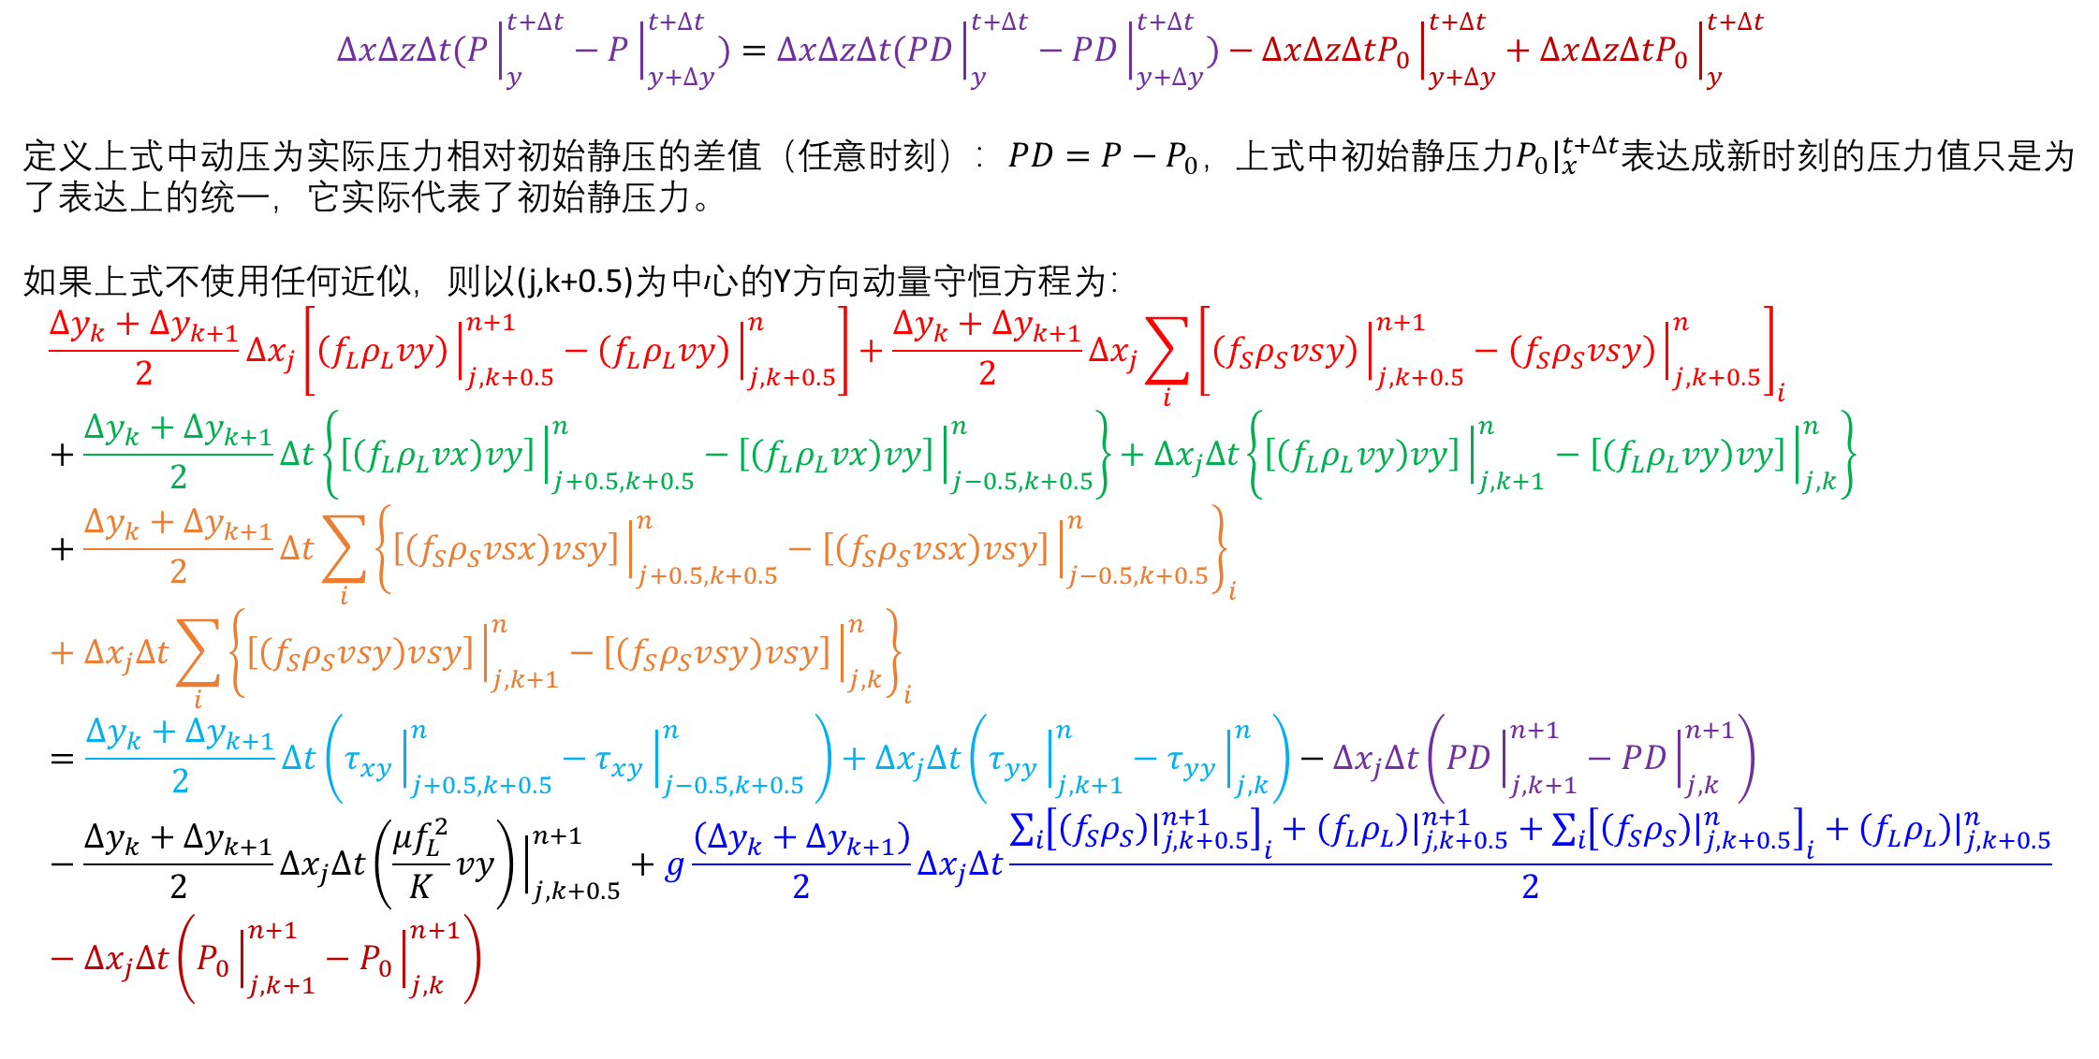

A. $P−\overset{⃑}{v}$ 方程离散(运动区-Y)
细说压力：Y方向
$$∆x∆z∆t(P{\left.​\right|}_{y}^{t+∆t}−P{\left.​\right|}_{y+∆y}^{t+∆t})=∆x∆z∆t(PD{\left.​\right|}_{y}^{t+∆t}−PD{\left.​\right|}_{y+∆y}^{t+∆t})−∆x∆z∆tP_{0}{\left.​\right|}_{y+∆y}^{t+∆t}+∆x∆z∆tP_{0}{\left.​\right|}_{y}^{t+∆t}$$
定义上式中动压为实际压力相对初始静压的差值（任意时刻）：$PD=P−P_{0}，$上式中初始静压力$P_{0}{\left.​\right|}_{x}^{t+∆t}$表达成新时刻的压力值只是为了表达上的统一，它实际代表了初始静压力。
如果上式不使用任何近似，则以(j,k+0.5)为中心的Y方向动量守恒方程为：
$$\frac{∆y_{k}+∆y_{k+1}}{2}∆x_{j}\left[\left(f_{L}ρ_{L}vy\right){\left.​\right|}_{j,k+0.5}^{n+1}−\left(f_{L}ρ_{L}vy\right){\left.​\right|}_{j,k+0.5}^{n}\right]+\frac{∆y_{k}+∆y_{k+1}}{2}∆x_{j}\sum_{i}{{\left[\left(f_{S}ρ_{S}vsy\right){\left.​\right|}_{j,k+0.5}^{n+1}−\left(f_{S}ρ_{S}vsy\right){\left.​\right|}_{j,k+0.5}^{n}\right]}_{i}}+\frac{∆y_{k}+∆y_{k+1}}{2}∆t\left\{\left[\left(f_{L}ρ_{L}vx\right)vy\right]{\left.​\right|}_{j+0.5,k+0.5}^{n}−\left[\left(f_{L}ρ_{L}vx\right)vy\right]{\left.​\right|}_{j−0.5,k+0.5}^{n}\right\}+∆x_{j}∆t\left\{\left[\left(f_{L}ρ_{L}vy\right)vy\right]{\left.​\right|}_{j,k+1}^{n}−\left[\left(f_{L}ρ_{L}vy\right)vy\right]{\left.​\right|}_{j,k}^{n}\right\}+\frac{∆y_{k}+∆y_{k+1}}{2}∆t\sum_{i}{{\left\{\left[\left(f_{S}ρ_{S}vsx\right)vsy\right]{\left.​\right|}_{j+0.5,k+0.5}^{n}−\left[\left(f_{S}ρ_{S}vsx\right)vsy\right]{\left.​\right|}_{j−0.5,k+0.5}^{n}\right\}}_{i}}+∆x_{j}∆t\sum_{i}{{\left\{\left[\left(f_{S}ρ_{S}vsy\right)vsy\right]{\left.​\right|}_{j,k+1}^{n}−\left[\left(f_{S}ρ_{S}vsy\right)vsy\right]{\left.​\right|}_{j,k}^{n}\right\}}_{i}}=\frac{∆y_{k}+∆y_{k+1}}{2}∆t\left(τ_{xy}{\left.​\right|}_{j+0.5,k+0.5}^{n}−τ_{xy}{\left.​\right|}_{j−0.5,k+0.5}^{n} \right)+∆x_{j}∆t\left(τ_{yy}{\left.​\right|}_{j,k+1}^{n}−τ_{yy}{\left.​\right|}_{j,k}^{n}\right)−∆x_{j}∆t\left(PD{\left.​\right|}_{j,k+1}^{n+1}−PD{\left.​\right|}_{j,k}^{n+1}\right)−\frac{∆y_{k}+∆y_{k+1}}{2}∆x_{j}∆t\left(\frac{μf_{L}^{2}}{K}vy\right){\left.​\right|}_{j,k+0.5}^{n+1}+g\frac{\left(∆y_{k}+∆y_{k+1}\right)}{2}∆x_{j}∆t\frac{\sum_{i}{{\left[\left(f_{S}ρ_{S}\right){\left.​\right|}_{j,k+0.5}^{n+1}\right]}_{i}}+\left(f_{L}ρ_{L}\right){\left.​\right|}_{j,k+0.5}^{n+1}+\sum_{i}{{\left[\left(f_{S}ρ_{S}\right){\left.​\right|}_{j,k+0.5}^{n}\right]}_{i}}+\left(f_{L}ρ_{L}\right){\left.​\right|}_{j,k+0.5}^{n}}{2}−∆x_{j}∆t\left(P_{0}{\left.​\right|}_{j,k+1}^{n+1}−P_{0}{\left.​\right|}_{j,k}^{n+1}\right)$$

Slide 5
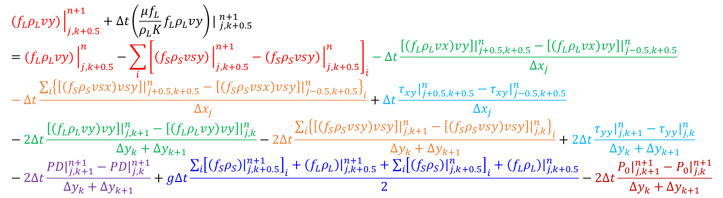
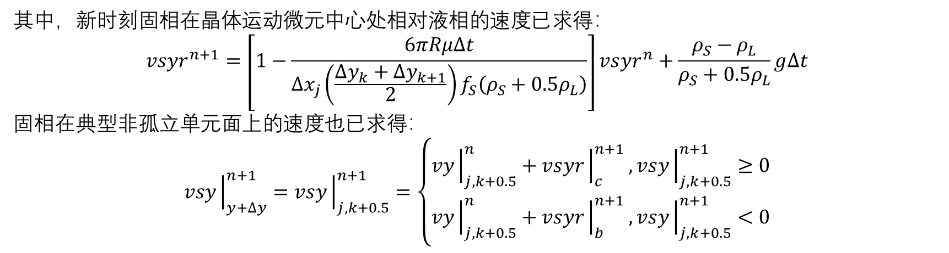
A. $P−\overset{⃑}{v}$ 方程离散(运动区-Y)
$${(f}_{L}ρ_{L}vy){\left.​\right|}_{j,k+0.5}^{n+1}+∆t{\left(\frac{μf_{L}}{ρ_{L}K}f_{L}ρ_{L}vy\right)| }_{j,k+0.5}^{n+1}={(f}_{L}ρ_{L}vy){\left.​\right|}_{j,k+0.5}^{n}−\sum_{i}{{\left[\left(f_{S}ρ_{S}vsy\right){\left.​\right|}_{j,k+0.5}^{n+1}−\left(f_{S}ρ_{S}vsy\right){\left.​\right|}_{j,k+0.5}^{n}\right]}_{i}}−∆t\frac{\left[\left(f_{L}ρ_{L}vx\right)vy\right]{\left.​\right|}_{j+0.5,k+0.5}^{n}−\left[\left(f_{L}ρ_{L}vx\right)vy\right]{\left.​\right|}_{j−0.5,k+0.5}^{n}}{∆x_{j}}−∆t\frac{\sum_{i}{{\left\{\left[\left(f_{S}ρ_{S}vsx\right)vsy\right]{\left.​\right|}_{j+0.5,k+0.5}^{n}−\left[\left(f_{S}ρ_{S}vsx\right)vsy\right]{\left.​\right|}_{j−0.5,k+0.5}^{n}\right\}}_{i}}}{∆x_{j}}+∆t\frac{τ_{xy}{\left.​\right|}_{j+0.5,k+0.5}^{n}−τ_{xy}{\left.​\right|}_{j−0.5,k+0.5}^{n}}{∆x_{j}}−2∆t\frac{\left[\left(f_{L}ρ_{L}vy\right)vy\right]{\left.​\right|}_{j,k+1}^{n}−\left[\left(f_{L}ρ_{L}vy\right)vy\right]{\left.​\right|}_{j,k}^{n}}{∆y_{k}+∆y_{k+1}}−2∆t\frac{\sum_{i}{{\left\{\left[\left(f_{S}ρ_{S}vsy\right)vsy\right]{\left.​\right|}_{j,k+1}^{n}−\left[\left(f_{S}ρ_{S}vsy\right)vsy\right]{\left.​\right|}_{j,k}^{n}\right\}}_{i}}}{∆y_{k}+∆y_{k+1}}+2∆t\frac{τ_{yy}{\left.​\right|}_{j,k+1}^{n}−τ_{yy}{\left.​\right|}_{j,k}^{n}}{∆y_{k}+∆y_{k+1}}−2∆t\frac{PD{\left.​\right|}_{j,k+1}^{n+1}−PD{\left.​\right|}_{j,k}^{n+1}}{∆y_{k}+∆y_{k+1}}+g∆t\frac{\sum_{i}{{\left[\left(f_{S}ρ_{S}\right){\left.​\right|}_{j,k+0.5}^{n+1}\right]}_{i}}+\left(f_{L}ρ_{L}\right){\left.​\right|}_{j,k+0.5}^{n+1}+\sum_{i}{{\left[\left(f_{S}ρ_{S}\right){\left.​\right|}_{j,k+0.5}^{n}\right]}_{i}}+\left(f_{L}ρ_{L}\right){\left.​\right|}_{j,k+0.5}^{n}}{2}−2∆t\frac{P_{0}{\left.​\right|}_{j,k+1}^{n+1}−P_{0}{\left.​\right|}_{j,k}^{n+1}}{∆y_{k}+∆y_{k+1}}$$
其中，新时刻固相在晶体运动微元中心处相对液相的速度已求得：
$$vsyr^{n+1}=\left[1−\frac{6πRμ∆t}{∆x_{j}\left(\frac{∆y_{k}+∆y_{k+1}}{2}\right)f_{S}\left(ρ_{S}+0.5ρ_{L}\right)}\right]vsyr^{n}+\frac{ρ_{S}−ρ_{L}}{ρ_{S}+0.5ρ_{L}}g∆t$$
固相在典型非孤立单元面上的速度也已求得：
$$vsy{\left.​\right|}_{y+∆y}^{n+1}=vsy{\left.​\right|}_{j,k+0.5}^{n+1}=\left\{\begin{aligned}vy{\left.​\right|}_{j,k+0.5}^{n}+vsyr{\left.​\right|}_{c}^{n+1}, vsy{\left.​\right|}_{j,k+0.5}^{n+1}≥0 \\ vy{\left.​\right|}_{j,k+0.5}^{n}+vsyr{\left.​\right|}_{b}^{n+1}, vsy{\left.​\right|}_{j,k+0.5}^{n+1}<0\end{aligned}\right.$$

Slide 6
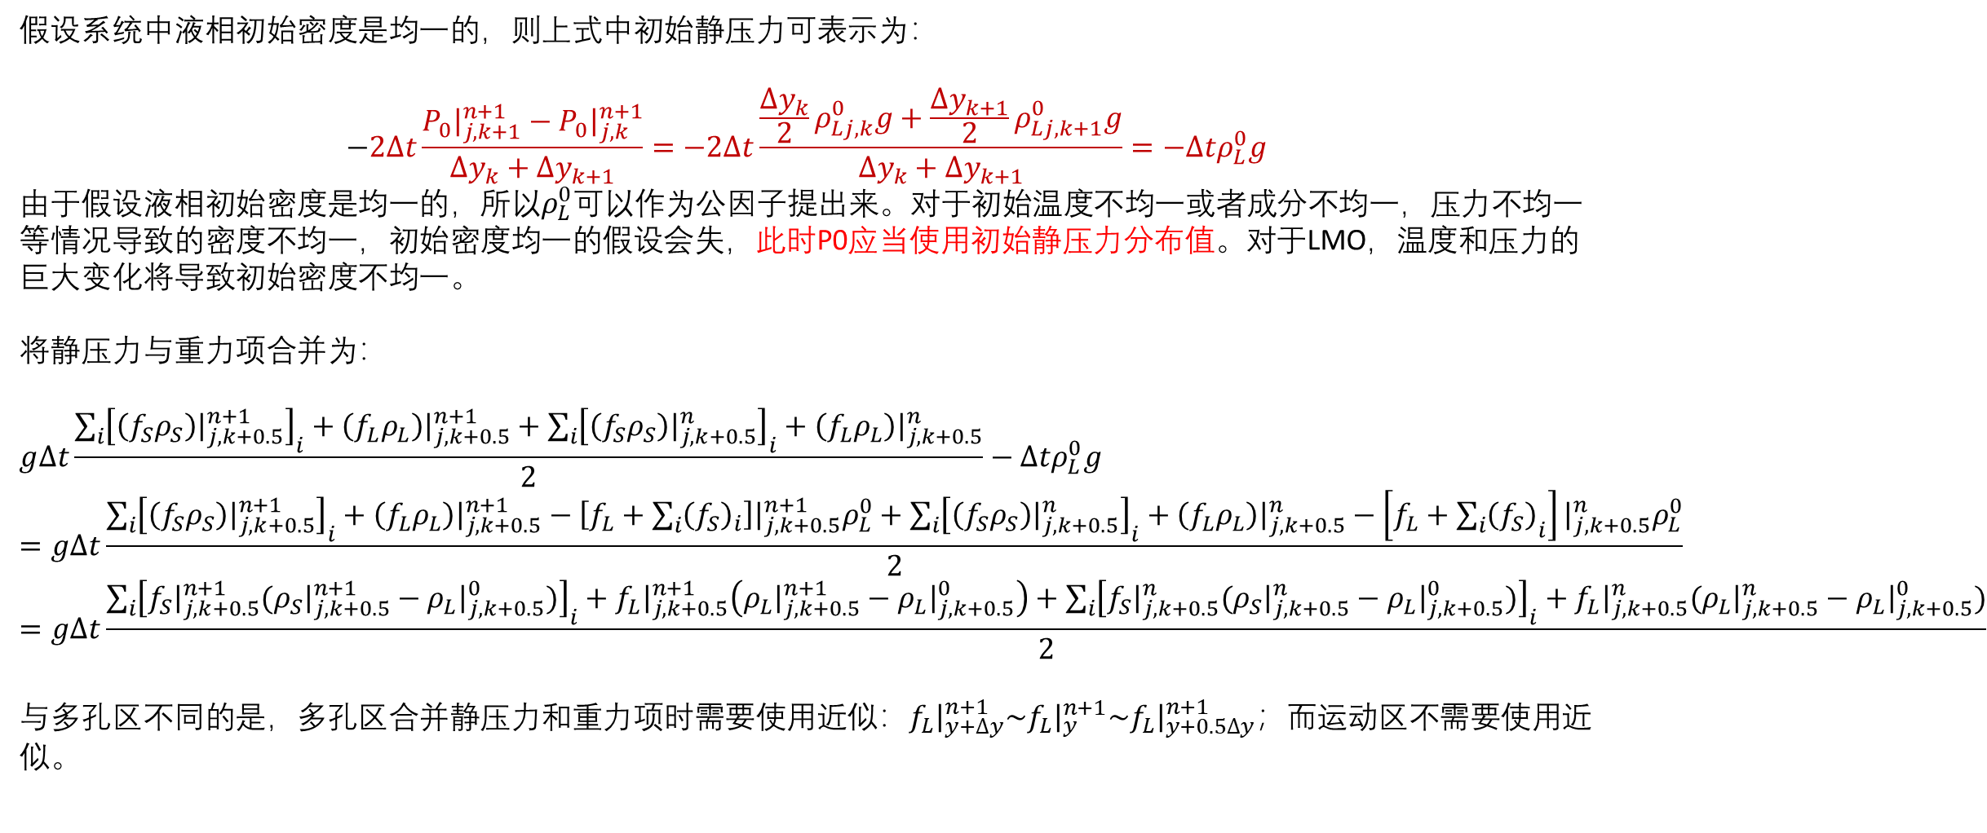
A. $P−\overset{⃑}{v}$ 方程离散(运动区-Y)
假设系统中液相初始密度是均一的，则上式中初始静压力可表示为：
$$−2∆t\frac{P_{0}{\left.​\right|}_{j,k+1}^{n+1}−P_{0}{\left.​\right|}_{j,k}^{n+1}}{∆y_{k}+∆y_{k+1}}=−2∆t\frac{\frac{∆y_{k}}{2}ρ_{Lj,k}^{0}g+\frac{∆y_{k+1}}{2}ρ_{Lj,k+1}^{0}g}{∆y_{k}+∆y_{k+1}}=−∆tρ_{L}^{0}g$$
由于假设液相初始密度是均一的，所以$ρ_{L}^{0}$可以作为公因子提出来。对于初始温度不均一或者成分不均一，压力不均一等情况导致的密度不均一，初始密度均一的假设会失，此时P0应当使用初始静压力分布值。对于LMO，温度和压力的巨大变化将导致初始密度不均一。
将静压力与重力项合并为：
$$g∆t\frac{\sum_{i}{{\left[\left(f_{S}ρ_{S}\right){\left.​\right|}_{j,k+0.5}^{n+1}\right]}_{i}+\left(f_{L}ρ_{L}\right){\left.​\right|}_{j,k+0.5}^{n+1}+\sum_{i}{{\left[\left(f_{S}ρ_{S}\right){\left.​\right|}_{j,k+0.5}^{n}\right]}_{i}}+\left(f_{L}ρ_{L}\right){\left.​\right|}_{j,k+0.5}^{n}}}{2}−∆tρ_{L}^{0}g=g∆t\frac{\sum_{i}{{\left[\left(f_{S}ρ_{S}\right){\left.​\right|}_{j,k+0.5}^{n+1}\right]}_{i}+\left(f_{L}ρ_{L}\right){\left.​\right|}_{j,k+0.5}^{n+1}−\left[f_{L}+\sum_{i}{{\left(f_{S}\right)}_{i}}\right]{\left.​\right|}_{j,k+0.5}^{n+1}ρ_{L}^{0}+\sum_{i}{{\left[\left(f_{S}ρ_{S}\right){\left.​\right|}_{j,k+0.5}^{n}\right]}_{i}}+\left(f_{L}ρ_{L}\right){\left.​\right|}_{j,k+0.5}^{n}−\left[f_{L}+{\sum_{i}{\left(f_{S}\right)}}_{i}\right]{\left.​\right|}_{j,k+0.5}^{n}ρ_{L}^{0}}}{2}=g∆t\frac{\sum_{i}{{\left[f_{S}{\left.​\right|}_{j,k+0.5}^{n+1}(ρ_{S}{\left.​\right|}_{j,k+0.5}^{n+1}−ρ_{L}{\left.​\right|}_{j,k+0.5}^{0})\right]}_{i}+f_{L}{\left.​\right|}_{j,k+0.5}^{n+1}\left(ρ_{L}{\left.​\right|}_{j,k+0.5}^{n+1}−ρ_{L}{\left.​\right|}_{j,k+0.5}^{0}\right)+\sum_{i}{{\left[f_{S}{\left.​\right|}_{j,k+0.5}^{n}(ρ_{S}{\left.​\right|}_{j,k+0.5}^{n}−ρ_{L}{\left.​\right|}_{j,k+0.5}^{0})\right]}_{i}}+f_{L}{\left.​\right|}_{j,k+0.5}^{n}(ρ_{L}{\left.​\right|}_{j,k+0.5}^{n}−ρ_{L}{\left.​\right|}_{j,k+0.5}^{0})}}{2}$$
与多孔区不同的是，多孔区合并静压力和重力项时需要使用近似：$f_{L}{\left.​\right|}_{y+∆y}^{n+1}\sim f_{L}{\left.​\right|}_{y}^{n+1}\sim f_{L}{\left.​\right|}_{y+0.5∆y}^{n+1}；$而运动区不需要使用近似。

Slide 7
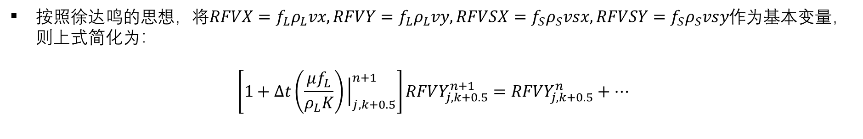
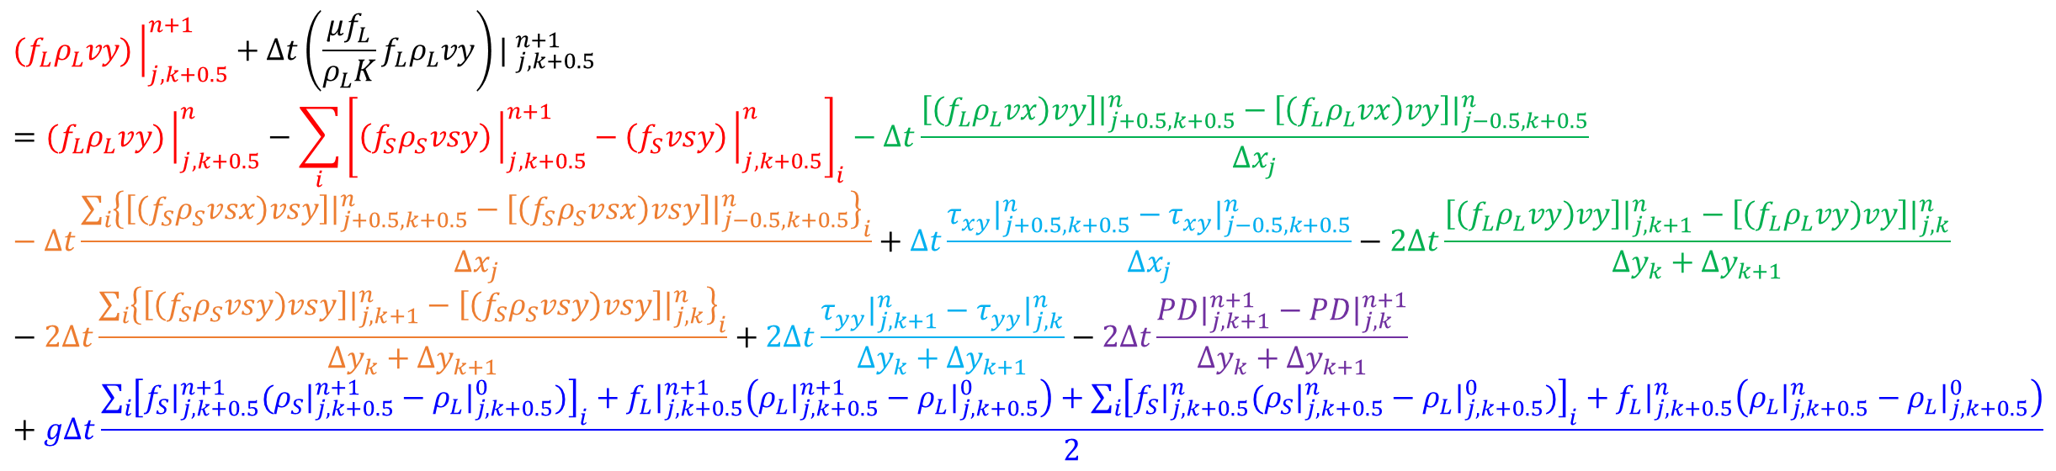
A. $P−\overset{⃑}{v}$ 方程离散(运动区-Y)
$${(f}_{L}ρ_{L}vy){\left.​\right|}_{j,k+0.5}^{n+1}+∆t{\left(\frac{μf_{L}}{ρ_{L}K}f_{L}ρ_{L}vy\right)| }_{j,k+0.5}^{n+1}={(f}_{L}ρ_{L}vy){\left.​\right|}_{j,k+0.5}^{n}−\sum_{i}{{\left[\left(f_{S}ρ_{S}vsy\right){\left.​\right|}_{j,k+0.5}^{n+1}−\left(f_{S}vsy\right){\left.​\right|}_{j,k+0.5}^{n}\right]}_{i}}−∆t\frac{\left[\left(f_{L}ρ_{L}vx\right)vy\right]{\left.​\right|}_{j+0.5,k+0.5}^{n}−\left[\left(f_{L}ρ_{L}vx\right)vy\right]{\left.​\right|}_{j−0.5,k+0.5}^{n}}{∆x_{j}}−∆t\frac{\sum_{i}{{\left\{\left[\left(f_{S}ρ_{S}vsx\right)vsy\right]{\left.​\right|}_{j+0.5,k+0.5}^{n}−\left[\left(f_{S}ρ_{S}vsx\right)vsy\right]{\left.​\right|}_{j−0.5,k+0.5}^{n}\right\}}_{i}}}{∆x_{j}}+∆t\frac{τ_{xy}{\left.​\right|}_{j+0.5,k+0.5}^{n}−τ_{xy}{\left.​\right|}_{j−0.5,k+0.5}^{n}}{∆x_{j}}−2∆t\frac{\left[\left(f_{L}ρ_{L}vy\right)vy\right]{\left.​\right|}_{j,k+1}^{n}−\left[\left(f_{L}ρ_{L}vy\right)vy\right]{\left.​\right|}_{j,k}^{n}}{∆y_{k}+∆y_{k+1}}−2∆t\frac{\sum_{i}{{\left\{\left[\left(f_{S}ρ_{S}vsy\right)vsy\right]{\left.​\right|}_{j,k+1}^{n}−\left[\left(f_{S}ρ_{S}vsy\right)vsy\right]{\left.​\right|}_{j,k}^{n}\right\}}_{i}}}{∆y_{k}+∆y_{k+1}}+2∆t\frac{τ_{yy}{\left.​\right|}_{j,k+1}^{n}−τ_{yy}{\left.​\right|}_{j,k}^{n}}{∆y_{k}+∆y_{k+1}}−2∆t\frac{PD{\left.​\right|}_{j,k+1}^{n+1}−PD{\left.​\right|}_{j,k}^{n+1}}{∆y_{k}+∆y_{k+1}}+g∆t\frac{\sum_{i}{{\left[f_{S}{\left.​\right|}_{j,k+0.5}^{n+1}(ρ_{S}{\left.​\right|}_{j,k+0.5}^{n+1}−ρ_{L}{\left.​\right|}_{j,k+0.5}^{0})\right]}_{i}}+f_{L}{\left.​\right|}_{j,k+0.5}^{n+1}\left(ρ_{L}{\left.​\right|}_{j,k+0.5}^{n+1}−ρ_{L}{\left.​\right|}_{j,k+0.5}^{0}\right)+\sum_{i}{{\left[f_{S}{\left.​\right|}_{j,k+0.5}^{n}(ρ_{S}{\left.​\right|}_{j,k+0.5}^{n}−ρ_{L}{\left.​\right|}_{j,k+0.5}^{0})\right]}_{i}}+f_{L}{\left.​\right|}_{j,k+0.5}^{n}\left(ρ_{L}{\left.​\right|}_{j,k+0.5}^{n}−ρ_{L}{\left.​\right|}_{j,k+0.5}^{0}\right)}{2}$$
按照徐达鸣的思想，将$RFVX=f_{L}ρ_{L}vx, RFVY=f_{L}ρ_{L}vy, RFVSX=f_{S}ρ_{S}vsx, RFVSY=f_{S}ρ_{S}vsy$作为基本变量，则上式简化为：
$$\left[1+∆t\left(\frac{μf_{L}}{ρ_{L}K}\right){\left.​\right|}_{j,k+0.5}^{n+1}\right]RFVY_{j,k+0.5}^{n+1}=RFVY_{j,k+0.5}^{n}+…$$
Notes:
注意：（1）压力需要减去初始压力，提高计算精度；（2）若y轴向上，则重力项取负；否则取正。

Slide 8
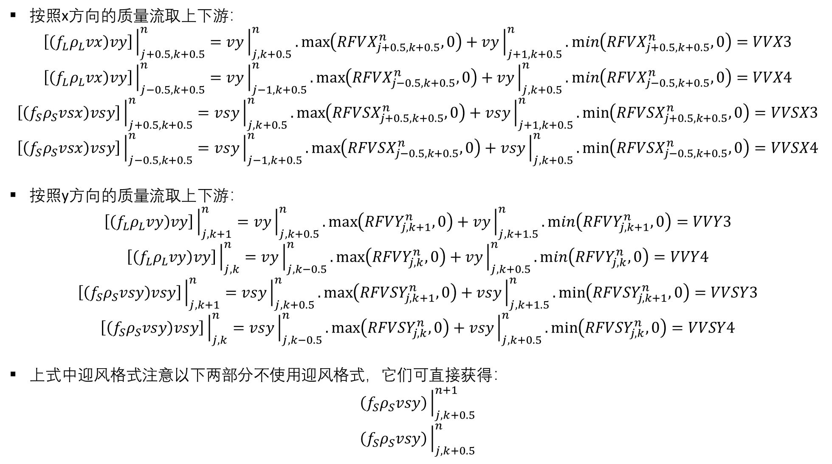
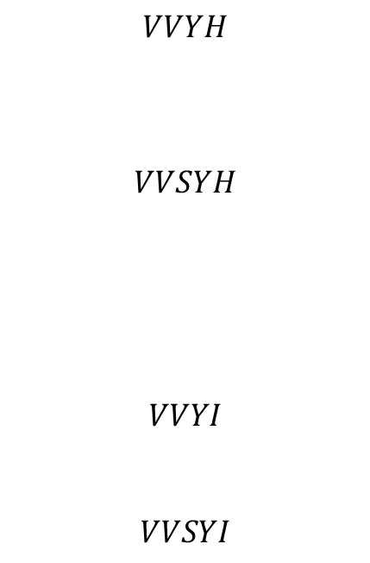
A. $P−\overset{⃑}{v}$ 方程离散(运动区-Y)
按照x方向的质量流取上下游：
$$\left[\left(f_{L}ρ_{L}vx\right)vy\right]{\left.​\right|}_{j+0.5,k+0.5}^{n}=vy{\left.​\right|}_{j,k+0.5}^{n}.\max\left(RFVX_{j+0.5,k+0.5}^{n},0\right)+vy{\left.​\right|}_{j+1,k+0.5}^{n}.\min\left(RFVX_{j+0.5,k+0.5}^{n},0\right)=VVX3$$
$$\left[\left(f_{L}ρ_{L}vx\right)vy\right]{\left.​\right|}_{j−0.5,k+0.5}^{n}=vy{\left.​\right|}_{j−1,k+0.5}^{n}.\max\left(RFVX_{j−0.5,k+0.5}^{n},0\right)+vy{\left.​\right|}_{j,k+0.5}^{n}.\min\left(RFVX_{j−0.5,k+0.5}^{n},0\right)=VVX4$$
$$\left[\left(f_{S}ρ_{S}vsx\right)vsy\right]{\left.​\right|}_{j+0.5,k+0.5}^{n}=vsy{\left.​\right|}_{j,k+0.5}^{n}.\max\left(RFVSX_{j+0.5,k+0.5}^{n},0\right)+vsy{\left.​\right|}_{j+1,k+0.5}^{n}.\min\left(RFVSX_{j+0.5,k+0.5}^{n},0\right)=VVSX3$$
$$\left[\left(f_{S}ρ_{S}vsx\right)vsy\right]{\left.​\right|}_{j−0.5,k+0.5}^{n}=vsy{\left.​\right|}_{j−1,k+0.5}^{n}.\max\left(RFVSX_{j−0.5,k+0.5}^{n},0\right)+vsy{\left.​\right|}_{j,k+0.5}^{n}.\min\left(RFVSX_{j−0.5,k+0.5}^{n},0\right)=VVSX4$$
按照y方向的质量流取上下游：
$$\left[\left(f_{L}ρ_{L}vy\right)vy\right]{\left.​\right|}_{j,k+1}^{n}=vy{\left.​\right|}_{j,k+0.5}^{n}.\max\left(RFVY_{j,k+1}^{n},0\right)+vy{\left.​\right|}_{j,k+1.5}^{n}.\min\left(RFVY_{j,k+1}^{n},0\right)=VVY3$$
$$\left[\left(f_{L}ρ_{L}vy\right)vy\right]{\left.​\right|}_{j,k}^{n}=vy{\left.​\right|}_{j,k−0.5}^{n}.\max\left(RFVY_{j,k}^{n},0\right)+vy{\left.​\right|}_{j,k+0.5}^{n}.\min\left(RFVY_{j,k}^{n},0\right)=VVY4$$
$$\left[\left(f_{S}ρ_{S}vsy\right)vsy\right]{\left.​\right|}_{j,k+1}^{n}=vsy{\left.​\right|}_{j,k+0.5}^{n}.\max\left(RFVSY_{j,k+1}^{n},0\right)+vsy{\left.​\right|}_{j,k+1.5}^{n}.\min\left(RFVSY_{j,k+1}^{n},0\right)=VVSY3$$
$$\left[\left(f_{S}ρ_{S}vsy\right)vsy\right]{\left.​\right|}_{j,k}^{n}=vsy{\left.​\right|}_{j,k−0.5}^{n}.\max\left(RFVSY_{j,k}^{n},0\right)+vsy{\left.​\right|}_{j,k+0.5}^{n}.\min\left(RFVSY_{j,k}^{n},0\right)=VVSY4$$
上式中迎风格式注意以下两部分不使用迎风格式，它们可直接获得：
$$\left(f_{S}ρ_{S}vsy\right){\left.​\right|}_{j,k+0.5}^{n+1}$$
$$\left(f_{S}ρ_{S}vsy\right){\left.​\right|}_{j,k+0.5}^{n}$$
$$VVYH$$
$$VVSYH$$
$$VVYI$$
$$VVSYI$$

Slide 9
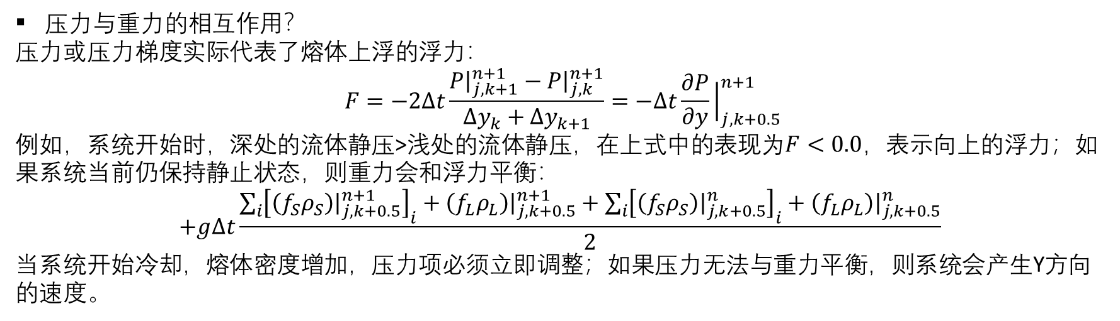
A. $P−\overset{⃑}{v}$ 方程离散(运动区-Y)
压力与重力的相互作用？
压力或压力梯度实际代表了熔体上浮的浮力：
$$F=−2∆t\frac{P{\left.​\right|}_{j,k+1}^{n+1}−P{\left.​\right|}_{j,k}^{n+1}}{∆y_{k}+∆y_{k+1}}=−∆t\frac{∂P}{∂y}{\left.​\right|}_{j,k+0.5}^{n+1}$$
例如，系统开始时，深处的流体静压>浅处的流体静压，在上式中的表现为$F<0.0$，表示向上的浮力；如果系统当前仍保持静止状态，则重力会和浮力平衡：
$$+g∆t\frac{\sum_{i}{{\left[\left(f_{S}ρ_{S}\right){\left.​\right|}_{j,k+0.5}^{n+1}\right]}_{i}+\left(f_{L}ρ_{L}\right){\left.​\right|}_{j,k+0.5}^{n+1}+\sum_{i}{{\left[\left(f_{S}ρ_{S}\right){\left.​\right|}_{j,k+0.5}^{n}\right]}_{i}}+\left(f_{L}ρ_{L}\right){\left.​\right|}_{j,k+0.5}^{n}}}{2}$$
当系统开始冷却，熔体密度增加，压力项必须立即调整；如果压力无法与重力平衡，则系统会产生Y方向的速度。

Slide 10
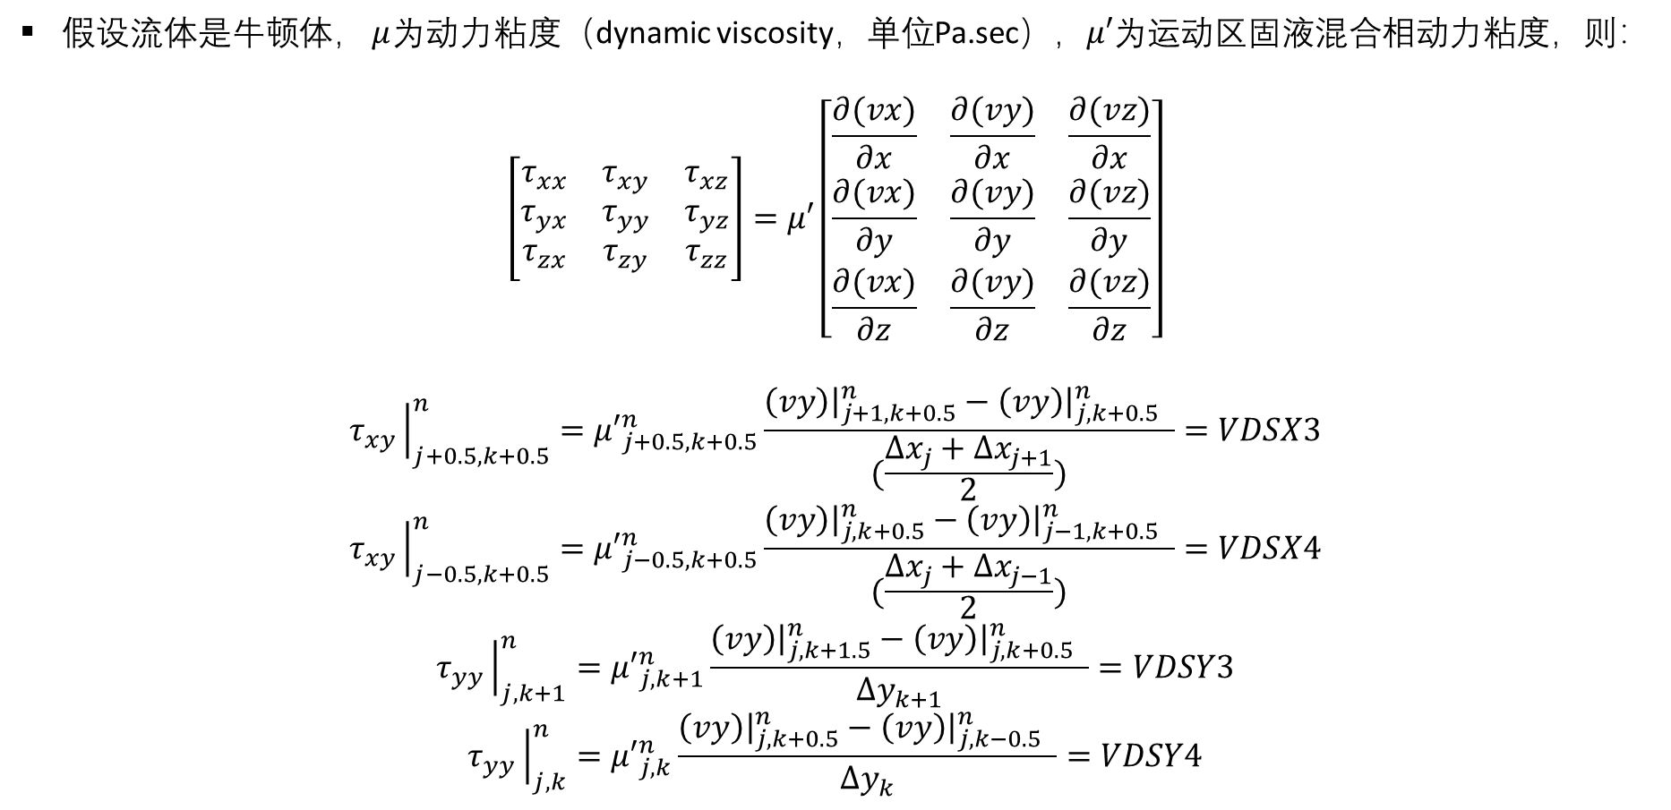
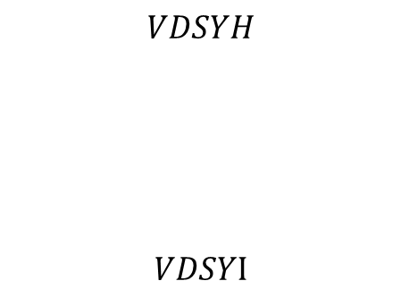
A. $P−\overset{⃑}{v}$ 方程离散(运动区-Y)
假设流体是牛顿体， $μ$为动力粘度（dynamic viscosity，单位Pa.sec），$μ′$为运动区固液混合相动力粘度，则：
$$\left[\begin{matrix}τ_{xx} & τ_{xy} & τ_{xz} \\ τ_{yx} & τ_{yy} & τ_{yz} \\ τ_{zx} & τ_{zy} & τ_{zz}\end{matrix}\right]=μ′\left[\begin{matrix}\frac{∂(vx)}{∂x} & \frac{∂(vy)}{∂x} & \frac{∂(vz)}{∂x} \\ \frac{∂(vx)}{∂y} & \frac{∂(vy)}{∂y} & \frac{∂(vz)}{∂y} \\ \frac{∂(vx)}{∂z} & \frac{∂(vy)}{∂z} & \frac{∂(vz)}{∂z}\end{matrix}\right]$$
$$τ_{xy}{\left.​\right|}_{j+0.5,k+0.5}^{n}={μ′}_{j+0.5,k+0.5}^{n}\frac{\left(vy\right){\left.​\right|}_{j+1,k+0.5}^{n}−\left(vy\right){\left.​\right|}_{j,k+0.5}^{n} }{(\frac{∆x_{j}+∆x_{j+1}}{2})}=VDSX3$$
$$τ_{xy}{\left.​\right|}_{j−0.5,k+0.5}^{n}={μ′}_{j−0.5,k+0.5}^{n}\frac{\left(vy\right){\left.​\right|}_{j,k+0.5}^{n}−\left(vy\right){\left.​\right|}_{j−1,k+0.5}^{n} }{(\frac{∆x_{j}+∆x_{j−1}}{2})}=VDSX4$$
$$τ_{yy}{\left.​\right|}_{j,k+1}^{n}={μ′}_{j,k+1}^{n}\frac{\left(vy\right){\left.​\right|}_{j,k+1.5}^{n}−\left(vy\right){\left.​\right|}_{j,k+0.5}^{n} }{∆y_{k+1}}=VDSY3$$
$$τ_{yy}{\left.​\right|}_{j,k}^{n}={μ′}_{j,k}^{n}\frac{\left(vy\right){\left.​\right|}_{j,k+0.5}^{n}−\left(vy\right){\left.​\right|}_{j,k−0.5}^{n} }{∆y_{k}}=VDSY4$$
$$VDSYH$$
$$VDSYI$$

Slide 11
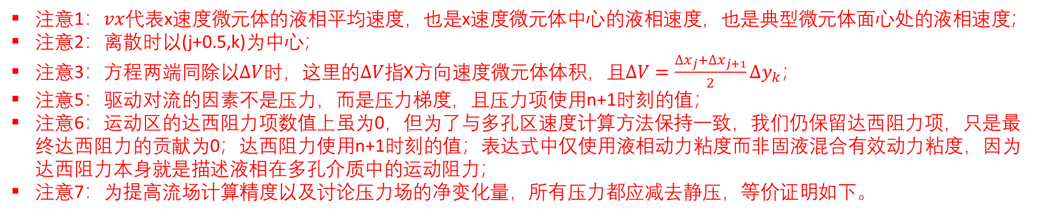
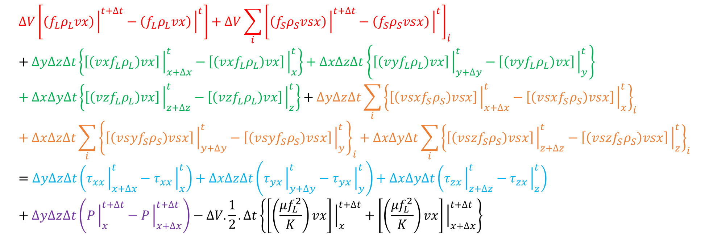
动量守恒方程（运动区-X）
X方向动量守恒方程：
$$∆V\left[\left(f_{L}ρ_{L}vx\right){\left.​\right|}^{t+∆t}−\left(f_{L}ρ_{L}vx\right){\left.​\right|}^{t}\right]+∆V\sum_{i}{{\left[\left(f_{S}ρ_{S}vsx\right){\left.​\right|}^{t+∆t}−\left(f_{S}ρ_{S}vsx\right){\left.​\right|}^{t}\right]}_{i}}+∆y∆z∆t\left\{\left[\left(vxf_{L}ρ_{L}\right)vx\right]{\left.​\right|}_{x+∆x}^{t}−\left[\left(vxf_{L}ρ_{L}\right)vx\right]{\left.​\right|}_{x}^{t}\right\}+∆x∆z∆t\left\{\left[\left(vyf_{L}ρ_{L}\right)vx\right]{\left.​\right|}_{y+∆y}^{t}−\left[\left(vyf_{L}ρ_{L}\right)vx\right]{\left.​\right|}_{y}^{t}\right\}+∆x∆y∆t\left\{\left[\left(vzf_{L}ρ_{L}\right)vx\right]{\left.​\right|}_{z+∆z}^{t}−\left[\left(vzf_{L}ρ_{L}\right)vx\right]{\left.​\right|}_{z}^{t}\right\}+∆y∆z∆t\sum_{i}{{\left\{\left[\left(vsxf_{S}ρ_{S}\right)vsx\right]{\left.​\right|}_{x+∆x}^{t}−\left[\left(vsxf_{S}ρ_{S}\right)vsx\right]{\left.​\right|}_{x}^{t}\right\}}_{i}}+∆x∆z∆t\sum_{i}{{\left\{\left[\left(vsyf_{S}ρ_{S}\right)vsx\right]{\left.​\right|}_{y+∆y}^{t}−\left[\left(vsyf_{S}ρ_{S}\right)vsx\right]{\left.​\right|}_{y}^{t}\right\}}_{i}}+∆x∆y∆t\sum_{i}{{\left\{\left[\left(vszf_{S}ρ_{S}\right)vsx\right]{\left.​\right|}_{z+∆z}^{t}−\left[\left(vszf_{S}ρ_{S}\right)vsx\right]{\left.​\right|}_{z}^{t}\right\}}_{i}}=∆y∆z∆t\left(τ_{xx}{\left.​\right|}_{x+∆x}^{t}−τ_{xx}{\left.​\right|}_{x}^{t}\right)+∆x∆z∆t\left(τ_{yx}{\left.​\right|}_{y+∆y}^{t}−τ_{yx}{\left.​\right|}_{y}^{t}\right)+∆x∆y∆t\left(τ_{zx}{\left.​\right|}_{z+∆z}^{t}−τ_{zx}{\left.​\right|}_{z}^{t}\right)+∆y∆z∆t\left(P{\left.​\right|}_{x}^{t+∆t}−P{\left.​\right|}_{x+∆x}^{t+∆t}\right)−∆V.\frac{1}{2}.∆t\left\{\left[\left(\frac{μf_{L}^{2}}{K}\right)vx\right]{\left.​\right|}_{x}^{t+∆t}+\left[\left(\frac{μf_{L}^{2}}{K}\right)vx\right]{\left.​\right|}_{x+∆x}^{t+∆t}\right\}$$
注意1：$vx$代表x速度微元体的液相平均速度，也是x速度微元体中心的液相速度，也是典型微元体面心处的液相速度；
注意2：离散时以(j+0.5,k)为中心；
注意3：方程两端同除以$∆V$时，这里的$∆V$指X方向速度微元体体积，且$∆V=\frac{∆x_{j}+∆x_{j+1}}{2}∆y_{k}$；
注意5：驱动对流的因素不是压力，而是压力梯度，且压力项使用n+1时刻的值；
注意6：运动区的达西阻力项数值上虽为0，但为了与多孔区速度计算方法保持一致，我们仍保留达西阻力项，只是最终达西阻力的贡献为0；达西阻力使用n+1时刻的值；表达式中仅使用液相动力粘度而非固液混合有效动力粘度，因为达西阻力本身就是描述液相在多孔介质中的运动阻力；
注意7：为提高流场计算精度以及讨论压力场的净变化量，所有压力都应减去静压，等价证明如下。

Slide 12
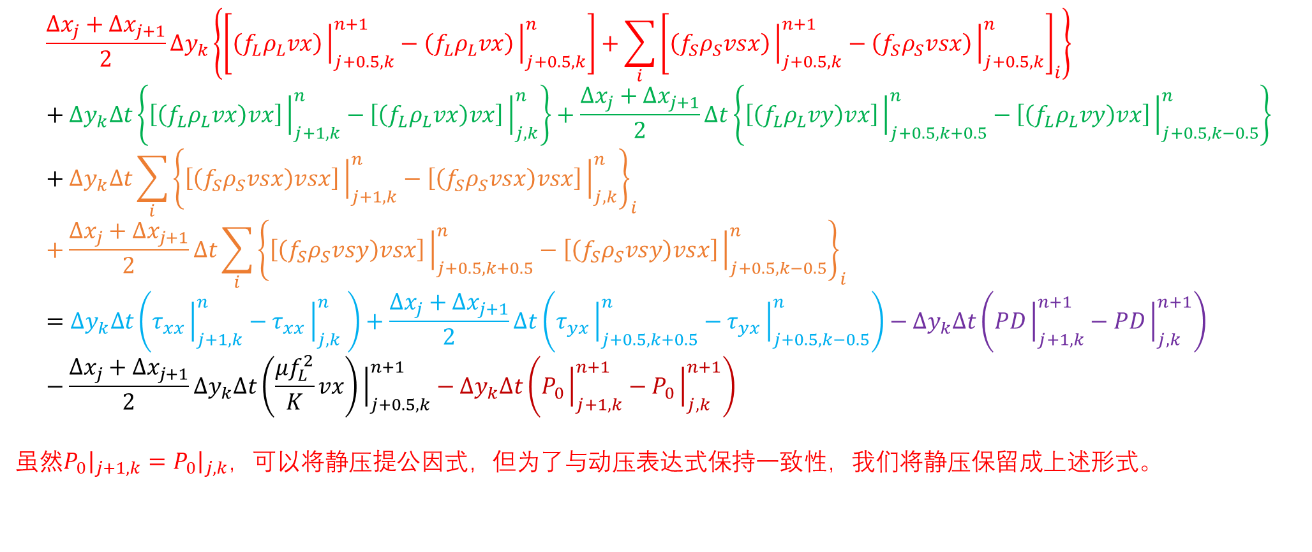

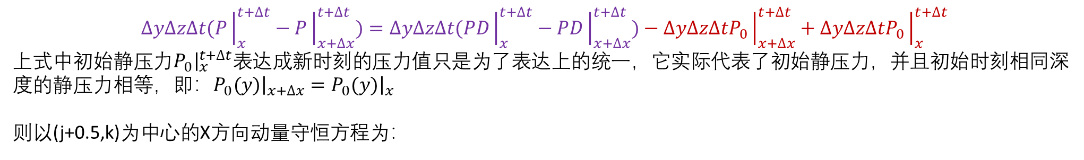
A. $P−\overset{⃑}{v}$ 方程离散(运动区-X)
细说压力：X方向
$$∆y∆z∆t(P{\left.​\right|}_{x}^{t+∆t}−P{\left.​\right|}_{x+∆x}^{t+∆t})=∆y∆z∆t(PD{\left.​\right|}_{x}^{t+∆t}−PD{\left.​\right|}_{x+∆x}^{t+∆t})−∆y∆z∆tP_{0}{\left.​\right|}_{x+∆x}^{t+∆t}+∆y∆z∆tP_{0}{\left.​\right|}_{x}^{t+∆t}$$
上式中初始静压力$P_{0}{\left.​\right|}_{x}^{t+∆t}$表达成新时刻的压力值只是为了表达上的统一，它实际代表了初始静压力，并且初始时刻相同深度的静压力相等，即：$P_{0}(y){\left.​\right|}_{x+∆x}=P_{0}(y){\left.​\right|}_{x}$
则以(j+0.5,k)为中心的X方向动量守恒方程为：
$$\frac{∆x_{j}+∆x_{j+1}}{2}∆y_{k}\left\{\left[\left(f_{L}ρ_{L}vx\right){\left.​\right|}_{j+0.5,k}^{n+1}−\left(f_{L}ρ_{L}vx\right){\left.​\right|}_{j+0.5,k}^{n}\right]+\sum_{i}{{\left[\left(f_{S}ρ_{S}vsx\right){\left.​\right|}_{j+0.5,k}^{n+1}−\left(f_{S}ρ_{S}vsx\right){\left.​\right|}_{j+0.5,k}^{n}\right]}_{i}}\right\}+∆y_{k}∆t\left\{\left[\left(f_{L}ρ_{L}vx\right)vx\right]{\left.​\right|}_{j+1,k}^{n}−\left[\left(f_{L}ρ_{L}vx\right)vx\right]{\left.​\right|}_{j,k}^{n}\right\}+\frac{∆x_{j}+∆x_{j+1}}{2}∆t\left\{\left[\left(f_{L}ρ_{L}vy\right)vx\right]{\left.​\right|}_{j+0.5,k+0.5}^{n}−\left[\left(f_{L}ρ_{L}vy\right)vx\right]{\left.​\right|}_{j+0.5,k−0.5}^{n}\right\}+∆y_{k}∆t\sum_{i}{{\left\{\left[\left(f_{S}ρ_{S}vsx\right)vsx\right]{\left.​\right|}_{j+1,k}^{n}−\left[\left(f_{S}ρ_{S}vsx\right)vsx\right]{\left.​\right|}_{j,k}^{n}\right\}}_{i}}+\frac{∆x_{j}+∆x_{j+1}}{2}∆t\sum_{i}{{\left\{\left[\left(f_{S}ρ_{S}vsy\right)vsx\right]{\left.​\right|}_{j+0.5,k+0.5}^{n}−\left[\left(f_{S}ρ_{S}vsy\right)vsx\right]{\left.​\right|}_{j+0.5,k−0.5}^{n}\right\}}_{i}}=∆y_{k}∆t\left(τ_{xx}{\left.​\right|}_{j+1,k}^{n}−τ_{xx}{\left.​\right|}_{j,k}^{n} \right)+\frac{∆x_{j}+∆x_{j+1}}{2}∆t\left(τ_{yx}{\left.​\right|}_{j+0.5,k+0.5}^{n}−τ_{yx}{\left.​\right|}_{j+0.5,k−0.5}^{n}\right)−∆y_{k}∆t\left(PD{\left.​\right|}_{j+1,k}^{n+1}−PD{\left.​\right|}_{j,k}^{n+1}\right)−\frac{∆x_{j}+∆x_{j+1}}{2}∆y_{k}∆t\left(\frac{μf_{L}^{2}}{K}vx\right){\left.​\right|}_{j+0.5,k}^{n+1}−∆y_{k}∆t\left(P_{0}{\left.​\right|}_{j+1,k}^{n+1}−P_{0}{\left.​\right|}_{j,k}^{n+1}\right)$$
虽然$P_{0}{\left.​\right|}_{j+1,k}=P_{0}{\left.​\right|}_{j,k}$，可以将静压提公因式，但为了与动压表达式保持一致性，我们将静压保留成上述形式。

Slide 13
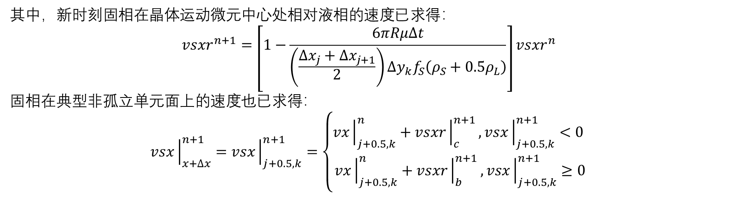
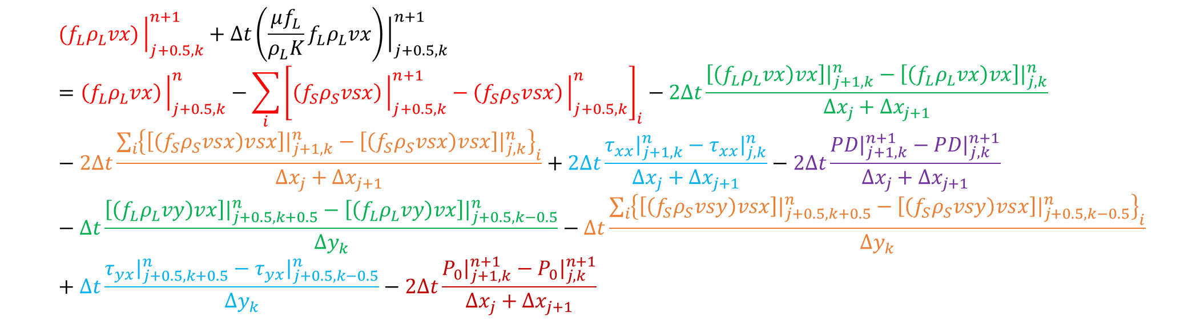
A. $P−\overset{⃑}{v}$ 方程离散(运动区-X)
$${(f}_{L}ρ_{L}vx){\left.​\right|}_{j+0.5,k}^{n+1}+∆t\left(\frac{μf_{L}}{ρ_{L}K}f_{L}ρ_{L}vx\right){\left.​\right|}_{j+0.5,k}^{n+1}=\left(f_{L}ρ_{L}vx\right){\left.​\right|}_{j+0.5,k}^{n}−\sum_{i}{{\left[\left(f_{S}ρ_{S}vsx\right){\left.​\right|}_{j+0.5,k}^{n+1}−\left(f_{S}ρ_{S}vsx\right){\left.​\right|}_{j+0.5,k}^{n}\right]}_{i}}−2∆t\frac{\left[\left(f_{L}ρ_{L}vx\right)vx\right]{\left.​\right|}_{j+1,k}^{n}−\left[\left(f_{L}ρ_{L}vx\right)vx\right]{\left.​\right|}_{j,k}^{n}}{∆x_{j}+∆x_{j+1}}−2∆t\frac{\sum_{i}{{\left\{\left[\left(f_{S}ρ_{S}vsx\right)vsx\right]{\left.​\right|}_{j+1,k}^{n}−\left[\left(f_{S}ρ_{S}vsx\right)vsx\right]{\left.​\right|}_{j,k}^{n}\right\}}_{i}}}{∆x_{j}+∆x_{j+1}}+2∆t\frac{τ_{xx}{\left.​\right|}_{j+1,k}^{n}−τ_{xx}{\left.​\right|}_{j,k}^{n}}{∆x_{j}+∆x_{j+1}}−2∆t\frac{PD{\left.​\right|}_{j+1,k}^{n+1}−PD{\left.​\right|}_{j,k}^{n+1}}{∆x_{j}+∆x_{j+1}}−∆t\frac{\left[\left(f_{L}ρ_{L}vy\right)vx\right]{\left.​\right|}_{j+0.5,k+0.5}^{n}−\left[\left(f_{L}ρ_{L}vy\right)vx\right]{\left.​\right|}_{j+0.5,k−0.5}^{n}}{∆y_{k}}−∆t\frac{\sum_{i}{{\left\{\left[\left(f_{S}ρ_{S}vsy\right)vsx\right]{\left.​\right|}_{j+0.5,k+0.5}^{n}−\left[\left(f_{S}ρ_{S}vsy\right)vsx\right]{\left.​\right|}_{j+0.5,k−0.5}^{n}\right\}}_{i}}}{∆y_{k}}+∆t\frac{τ_{yx}{\left.​\right|}_{j+0.5,k+0.5}^{n}−τ_{yx}{\left.​\right|}_{j+0.5,k−0.5}^{n}}{∆y_{k}}−2∆t\frac{P_{0}{\left.​\right|}_{j+1,k}^{n+1}−P_{0}{\left.​\right|}_{j,k}^{n+1}}{∆x_{j}+∆x_{j+1}}$$
其中，新时刻固相在晶体运动微元中心处相对液相的速度已求得：
$$vsxr^{n+1}=\left[1−\frac{6πRμ∆t}{\left(\frac{∆x_{j}+∆x_{j+1}}{2}\right)∆y_{k}f_{S}\left(ρ_{S}+0.5ρ_{L}\right)}\right]vsxr^{n}$$
固相在典型非孤立单元面上的速度也已求得：
$$vsx{\left.​\right|}_{x+∆x}^{n+1}=vsx{\left.​\right|}_{j+0.5,k}^{n+1}=\left\{\begin{aligned}vx{\left.​\right|}_{j+0.5,k}^{n}+vsxr{\left.​\right|}_{c}^{n+1}, vsx{\left.​\right|}_{j+0.5,k}^{n+1}<0 \\ vx{\left.​\right|}_{j+0.5,k}^{n}+vsxr{\left.​\right|}_{b}^{n+1}, vsx{\left.​\right|}_{j+0.5,k}^{n+1}≥0\end{aligned}\right.$$

Slide 14
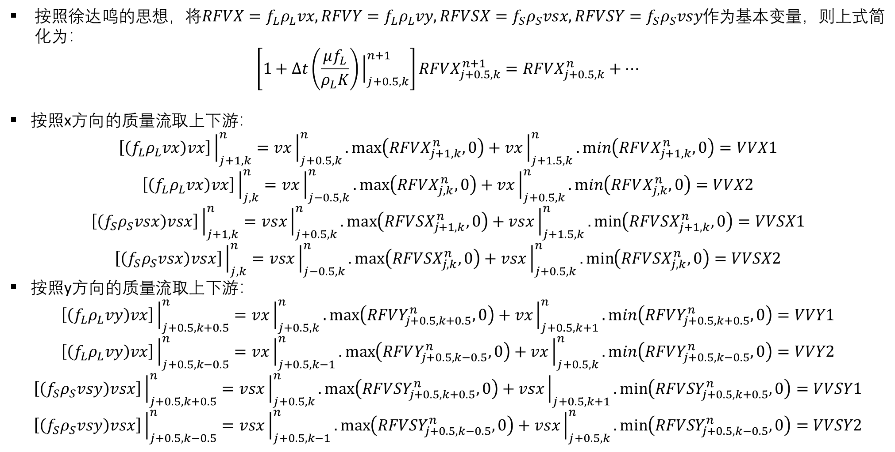
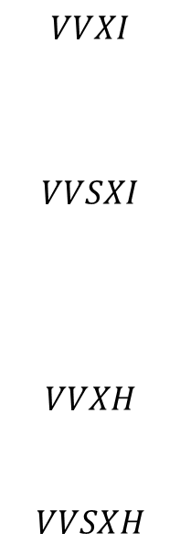
A. $P−\overset{⃑}{v}$ 方程离散(运动区-X)
按照徐达鸣的思想，将$RFVX=f_{L}ρ_{L}vx, RFVY=f_{L}ρ_{L}vy, RFVSX=f_{S}ρ_{S}vsx, RFVSY=f_{S}ρ_{S}vsy$作为基本变量，则上式简化为：
$$\left[1+∆t\left(\frac{μf_{L}}{ρ_{L}K}\right){\left.​\right|}_{j+0.5,k}^{n+1}\right]RFVX_{j+0.5,k}^{n+1}=RFVX_{j+0.5,k}^{n}+…$$
按照x方向的质量流取上下游：
$$\left[\left(f_{L}ρ_{L}vx\right)vx\right]{\left.​\right|}_{j+1,k}^{n}=vx{\left.​\right|}_{j+0.5,k}^{n}.\max\left(RFVX_{j+1,k}^{n},0\right)+vx{\left.​\right|}_{j+1.5,k}^{n}.\min\left(RFVX_{j+1,k}^{n},0\right)=VVX1$$
$$\left[\left(f_{L}ρ_{L}vx\right)vx\right]{\left.​\right|}_{j,k}^{n}=vx{\left.​\right|}_{j−0.5,k}^{n}.\max\left(RFVX_{j,k}^{n},0\right)+vx{\left.​\right|}_{j+0.5,k}^{n}.\min\left(RFVX_{j,k}^{n},0\right)=VVX2$$
$$\left[\left(f_{S}ρ_{S}vsx\right)vsx\right]{\left.​\right|}_{j+1,k}^{n}=vsx{\left.​\right|}_{j+0.5,k}^{n}.\max\left(RFVSX_{j+1,k}^{n},0\right)+vsx{\left.​\right|}_{j+1.5,k}^{n}.\min\left(RFVSX_{j+1,k}^{n},0\right)=VVSX1$$
$$\left[\left(f_{S}ρ_{S}vsx\right)vsx\right]{\left.​\right|}_{j,k}^{n}=vsx{\left.​\right|}_{j−0.5,k}^{n}.\max\left(RFVSX_{j,k}^{n},0\right)+vsx{\left.​\right|}_{j+0.5,k}^{n}.\min\left(RFVSX_{j,k}^{n},0\right)=VVSX2$$
按照y方向的质量流取上下游：
$$\left[\left(f_{L}ρ_{L}vy\right)vx\right]{\left.​\right|}_{j+0.5,k+0.5}^{n}=vx{\left.​\right|}_{j+0.5,k}^{n}.\max\left(RFVY_{j+0.5,k+0.5}^{n},0\right)+vx{\left.​\right|}_{j+0.5,k+1}^{n}.\min\left(RFVY_{j+0.5,k+0.5}^{n},0\right)=VVY1$$
$$\left[\left(f_{L}ρ_{L}vy\right)vx\right]{\left.​\right|}_{j+0.5,k−0.5}^{n}=vx{\left.​\right|}_{j+0.5,k−1}^{n}.\max\left(RFVY_{j+0.5,k−0.5}^{n},0\right)+vx{\left.​\right|}_{j+0.5,k}^{n}.\min\left(RFVY_{j+0.5,k−0.5}^{n},0\right)=VVY2$$
$$\left[\left(f_{S}ρ_{S}vsy\right)vsx\right]{\left.​\right|}_{j+0.5,k+0.5}^{n}=vsx{\left.​\right|}_{j+0.5,k}^{n}.\max\left(RFVSY_{j+0.5,k+0.5}^{n},0\right)+vsx{\left.​\right|}_{j+0.5,k+1}.\min\left(RFVSY_{j+0.5,k+0.5}^{n},0\right)=VVSY1$$
$$\left[\left(f_{S}ρ_{S}vsy\right)vsx\right]{\left.​\right|}_{j+0.5,k−0.5}^{n}=vsx{\left.​\right|}_{j+0.5,k−1}^{n}.\max\left(RFVSY_{j+0.5,k−0.5}^{n},0\right)+vsx{\left.​\right|}_{j+0.5,k}^{n}.\min\left(RFVSY_{j+0.5,k−0.5}^{n},0\right)=VVSY2$$
$$VVXI$$
$$VVSXI$$
$$VVXH$$
$$VVSXH$$

Slide 15
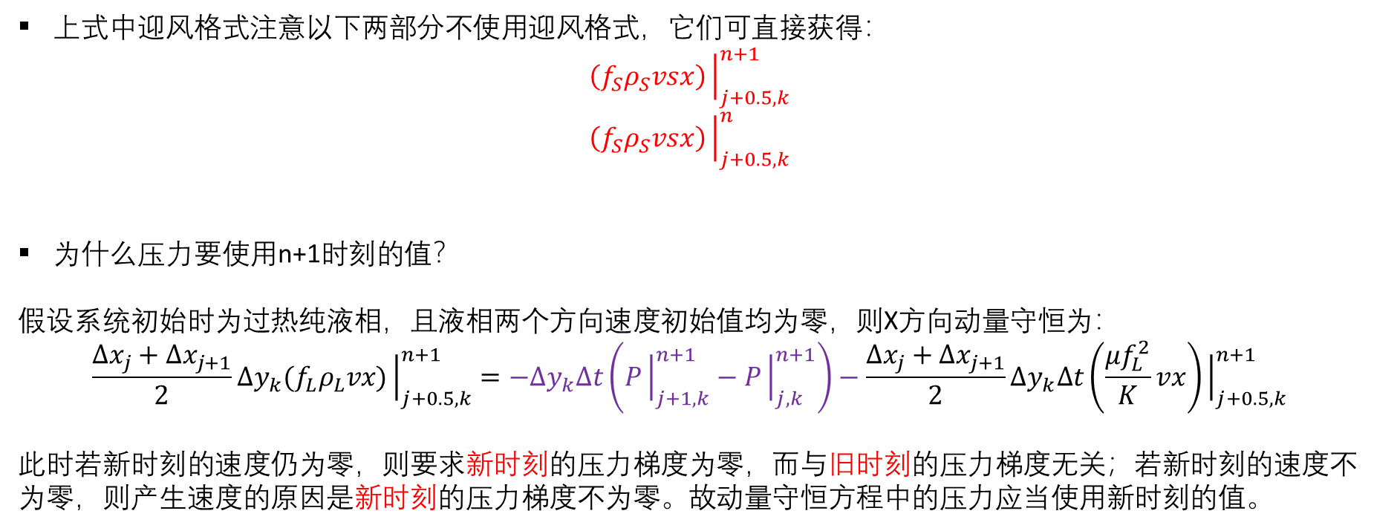
A. $P−\overset{⃑}{v}$ 方程离散(运动区-X)
上式中迎风格式注意以下两部分不使用迎风格式，它们可直接获得：
$$\left(f_{S}ρ_{S}vsx\right){\left.​\right|}_{j+0.5,k}^{n+1}$$
$$\left(f_{S}ρ_{S}vsx\right){\left.​\right|}_{j+0.5,k}^{n}$$
为什么压力要使用n+1时刻的值？
假设系统初始时为过热纯液相，且液相两个方向速度初始值均为零，则X方向动量守恒为：
$$\frac{∆x_{j}+∆x_{j+1}}{2}∆y_{k}{(f}_{L}ρ_{L}vx){\left.​\right|}_{j+0.5,k}^{n+1}=−∆y_{k}∆t\left(P{\left.​\right|}_{j+1,k}^{n+1}−P{\left.​\right|}_{j,k}^{n+1}\right)−\frac{∆x_{j}+∆x_{j+1}}{2}∆y_{k}∆t\left(\frac{μf_{L}^{2}}{K}vx\right){\left.​\right|}_{j+0.5,k}^{n+1}$$
此时若新时刻的速度仍为零，则要求新时刻的压力梯度为零，而与旧时刻的压力梯度无关；若新时刻的速度不为零，则产生速度的原因是新时刻的压力梯度不为零。故动量守恒方程中的压力应当使用新时刻的值。

Slide 16
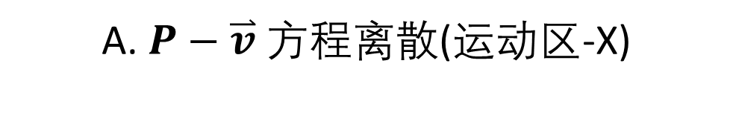
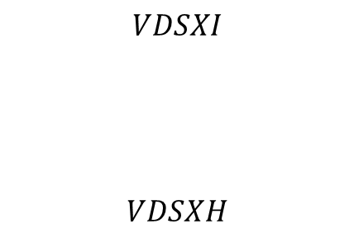
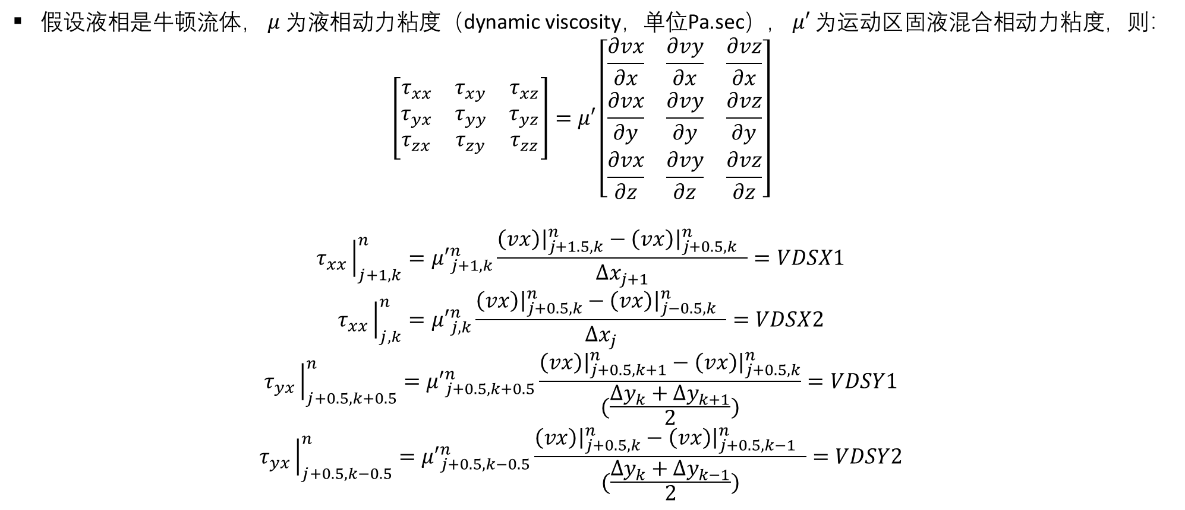
A. $P−\overset{⃑}{v}$ 方程离散(运动区-X)
假设液相是牛顿流体，$μ$为液相动力粘度（dynamic viscosity，单位Pa.sec），$μ′$为运动区固液混合相动力粘度，则：
$$\left[\begin{matrix}τ_{xx} & τ_{xy} & τ_{xz} \\ τ_{yx} & τ_{yy} & τ_{yz} \\ τ_{zx} & τ_{zy} & τ_{zz}\end{matrix}\right]=μ′\left[\begin{matrix}\frac{∂vx}{∂x} & \frac{∂vy}{∂x} & \frac{∂vz}{∂x} \\ \frac{∂vx}{∂y} & \frac{∂vy}{∂y} & \frac{∂vz}{∂y} \\ \frac{∂vx}{∂z} & \frac{∂vy}{∂z} & \frac{∂vz}{∂z}\end{matrix}\right]$$
$$τ_{xx}{\left.​\right|}_{j+1,k}^{n}={μ′}_{j+1,k}^{n}\frac{\left(vx\right){\left.​\right|}_{j+1.5,k}^{n}−\left(vx\right){\left.​\right|}_{j+0.5,k}^{n} }{∆x_{j+1}}=VDSX1$$
$$τ_{xx}{\left.​\right|}_{j,k}^{n}={μ′}_{j,k}^{n}\frac{\left(vx\right){\left.​\right|}_{j+0.5,k}^{n}−\left(vx\right){\left.​\right|}_{j−0.5,k}^{n} }{∆x_{j}}=VDSX2$$
$$τ_{yx}{\left.​\right|}_{j+0.5,k+0.5}^{n}={μ′}_{j+0.5,k+0.5}^{n}\frac{\left(vx\right){\left.​\right|}_{j+0.5,k+1}^{n}−\left(vx\right){\left.​\right|}_{j+0.5,k}^{n}}{(\frac{∆y_{k}+∆y_{k+1}}{2})}=VDSY1$$
$$τ_{yx}{\left.​\right|}_{j+0.5,k−0.5}^{n}={μ′}_{j+0.5,k−0.5}^{n}\frac{\left(vx\right){\left.​\right|}_{j+0.5,k}^{n}−\left(vx\right){\left.​\right|}_{j+0.5,k−1}^{n} }{(\frac{∆y_{k}+∆y_{k−1}}{2})}=VDSY2$$
$$VDSXI$$
$$VDSXH$$
Notes:
Bulk viscosity

Slide 17

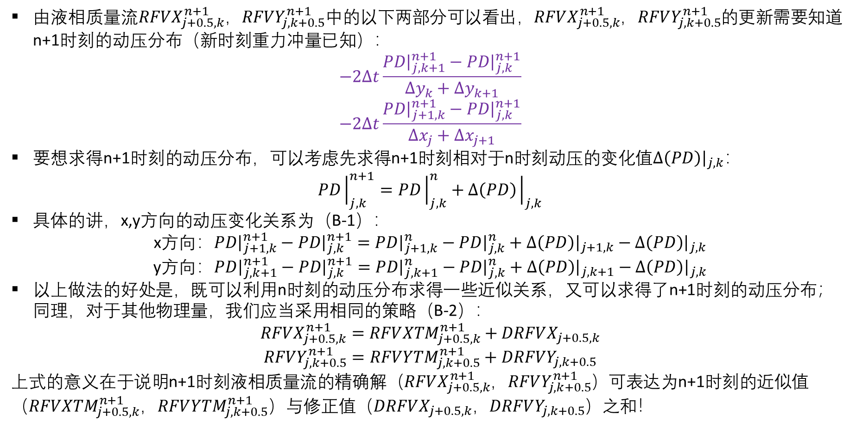
B. $P−\overset{⃑}{v}$ 求解算法（徐）
由液相质量流$RFVX_{j+0.5,k}^{n+1}$，$RFVY_{j,k+0.5}^{n+1}$中的以下两部分可以看出，$RFVX_{j+0.5,k}^{n+1}$，$RFVY_{j,k+0.5}^{n+1}$的更新需要知道n+1时刻的动压分布（新时刻重力冲量已知）：
$$−2∆t\frac{PD{\left.​\right|}_{j,k+1}^{n+1}−PD{\left.​\right|}_{j,k}^{n+1}}{∆y_{k}+∆y_{k+1}}$$
$$−2∆t\frac{PD{\left.​\right|}_{j+1,k}^{n+1}−PD{\left.​\right|}_{j,k}^{n+1}}{∆x_{j}+∆x_{j+1}}$$
要想求得n+1时刻的动压分布，可以考虑先求得n+1时刻相对于n时刻动压的变化值$∆\left(PD\right){\left.​\right|}_{j,k}$：
$$PD{\left.​\right|}_{j,k}^{n+1}=PD{\left.​\right|}_{j,k}^{n}+∆\left(PD\right){\left.​\right|}_{j,k}$$
具体的讲，x,y方向的动压变化关系为（B-1）：
x方向：$PD{\left.​\right|}_{j+1,k}^{n+1}−PD{\left.​\right|}_{j,k}^{n+1}=PD{\left.​\right|}_{j+1,k}^{n}−PD{\left.​\right|}_{j,k}^{n}+∆\left(PD\right){\left.​\right|}_{j+1,k}−∆\left(PD\right){\left.​\right|}_{j,k}$
y方向：$PD{\left.​\right|}_{j,k+1}^{n+1}−PD{\left.​\right|}_{j,k}^{n+1}=PD{\left.​\right|}_{j,k+1}^{n}−PD{\left.​\right|}_{j,k}^{n}+∆\left(PD\right){\left.​\right|}_{j,k+1}−∆\left(PD\right){\left.​\right|}_{j,k}$
以上做法的好处是，既可以利用n时刻的动压分布求得一些近似关系，又可以求得了n+1时刻的动压分布；同理，对于其他物理量，我们应当采用相同的策略（B-2）：
$$RFVX_{j+0.5,k}^{n+1}=RFV{XTM}_{j+0.5,k}^{n+1}+DRFVX_{j+0.5,k}$$
$$RFVY_{j,k+0.5}^{n+1}=RFV{YTM}_{j,k+0.5}^{n+1}+DRFVY_{j,k+0.5}$$
上式的意义在于说明n+1时刻液相质量流的精确解（$RFVX_{j+0.5,k}^{n+1}$，$RFVY_{j,k+0.5}^{n+1}$）可表达为n+1时刻的近似值（$RFV{XTM}_{j+0.5,k}^{n+1}$，$RFV{YTM}_{j,k+0.5}^{n+1}$）与修正值（$DRFVX_{j+0.5,k}$，$DRFVY_{j,k+0.5}$）之和！

Slide 18
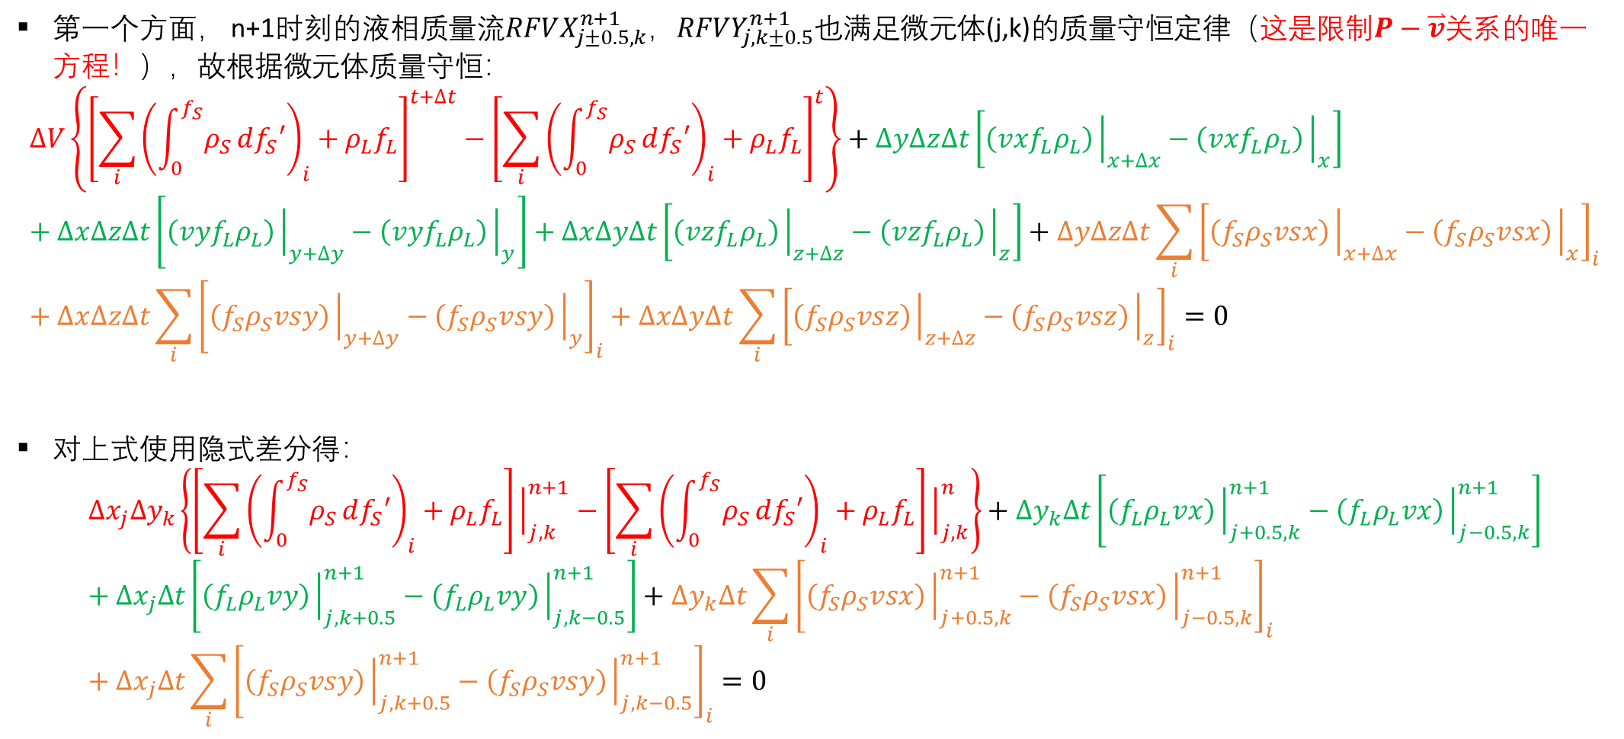
B. $P−\overset{⃑}{v}$ 求解算法（徐）
第一个方面， n+1时刻的液相质量流$RFVX_{j±0.5,k}^{n+1}$，$RFVY_{j,k±0.5}^{n+1}$也满足微元体(j,k)的质量守恒定律（这是限制$P−\overset{⃑}{v}$关系的唯一方程！），故根据微元体质量守恒：
$$∆V\left\{{\left[\sum_{i}{{\left(\int_{0}^{f_{S}}{ρ_{S}}df_{S}′\right)}_{i}+ρ_{L}f_{L}}\right]}^{t+∆t}−{\left[\sum_{i}{{\left(\int_{0}^{f_{S}}{ρ_{S}}df_{S}′\right)}_{i}+ρ_{L}f_{L}}\right]}^{t}\right\}+∆y∆z∆t\left[\left(vxf_{L}ρ_{L}\right){\left.​\right|}_{x+∆x}−\left(vxf_{L}ρ_{L}\right){\left.​\right|}_{x}\right]+∆x∆z∆t\left[\left(vyf_{L}ρ_{L}\right){\left.​\right|}_{y+∆y}−\left(vyf_{L}ρ_{L}\right){\left.​\right|}_{y}\right]+∆x∆y∆t\left[\left(vzf_{L}ρ_{L}\right){\left.​\right|}_{z+∆z}−\left(vzf_{L}ρ_{L}\right){\left.​\right|}_{z}\right]+∆y∆z∆t\sum_{i}{{\left[\left(f_{S}ρ_{S}vsx\right){\left.​\right|}_{x+∆x}−\left(f_{S}ρ_{S}vsx\right){\left.​\right|}_{x}\right]}_{i}}+∆x∆z∆t\sum_{i}{{\left[\left(f_{S}ρ_{S}vsy\right){\left.​\right|}_{y+∆y}−\left(f_{S}ρ_{S}vsy\right){\left.​\right|}_{y}\right]}_{i}}+∆x∆y∆t\sum_{i}{{\left[\left(f_{S}ρ_{S}vsz\right){\left.​\right|}_{z+∆z}−\left(f_{S}ρ_{S}vsz\right){\left.​\right|}_{z}\right]}_{i}}=0$$
对上式使用隐式差分得$：$
$$∆x_{j}{∆y}_{k}\left\{\left[\sum_{i}{{\left(\int_{0}^{f_{S}}{ρ_{S}}df_{S}′\right)}_{i}}+ρ_{L}f_{L}\right]{\left.​\right|}_{j,k}^{n+1}−\left[\sum_{i}{{\left(\int_{0}^{f_{S}}{ρ_{S}}df_{S}′\right)}_{i}}+ρ_{L}f_{L}\right]{\left.​\right|}_{j,k}^{n}\right\}+∆y_{k}∆t\left[\left(f_{L}ρ_{L}vx\right){\left.​\right|}_{j+0.5,k}^{n+1}−\left(f_{L}ρ_{L}vx\right){\left.​\right|}_{j−0.5,k}^{n+1}\right]+∆x_{j}∆t\left[\left(f_{L}ρ_{L}vy\right){\left.​\right|}_{j,k+0.5}^{n+1}−\left(f_{L}ρ_{L}vy\right){\left.​\right|}_{j,k−0.5}^{n+1}\right]+∆y_{k}∆t\sum_{i}{{\left[\left(f_{S}ρ_{S}vsx\right){\left.​\right|}_{j+0.5,k}^{n+1}−\left(f_{S}ρ_{S}vsx\right){\left.​\right|}_{j−0.5,k}^{n+1}\right]}_{i}}+∆x_{j}∆t\sum_{i}{{\left[\left(f_{S}ρ_{S}vsy\right){\left.​\right|}_{j,k+0.5}^{n+1}−\left(f_{S}ρ_{S}vsy\right){\left.​\right|}_{j,k−0.5}^{n+1}\right]}_{i}}=0$$

Slide 19
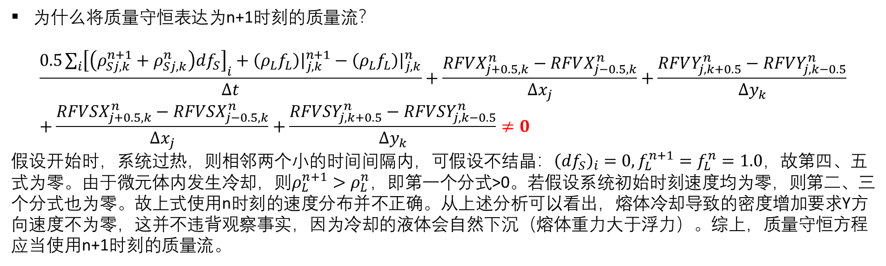
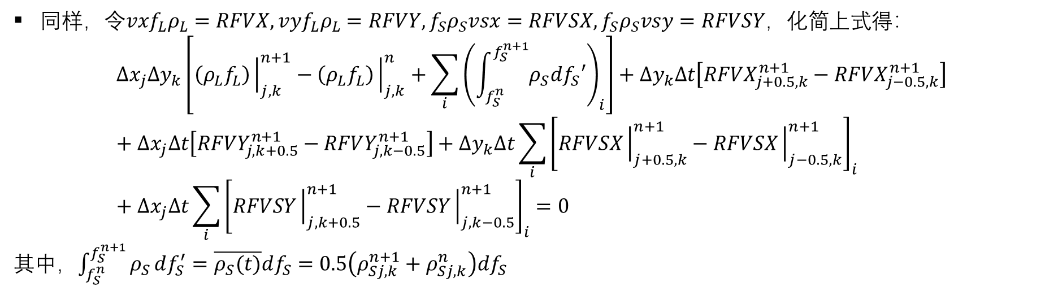
B. $P−\overset{⃑}{v}$ 求解算法（徐）
同样，令$vxf_{L}ρ_{L}=RFVX,vyf_{L}ρ_{L}=RFVY, f_{S}ρ_{S}vsx=RFVSX, f_{S}ρ_{S}vsy=RFVSY$，化简上式得：
$$∆x_{j}{∆y}_{k}\left[\left(ρ_{L}f_{L}\right){\left.​\right|}_{j,k}^{n+1}−\left(ρ_{L}f_{L}\right){\left.​\right|}_{j,k}^{n}+\sum_{i}{{\left(\int_{f_{S}^{n}}^{f_{S}^{n+1}}{ρ_{S}df_{S}′}\right)}_{i}}\right]+∆y_{k}∆t\left[RFVX_{j+0.5,k}^{n+1}−RFVX_{j−0.5,k}^{n+1}\right]+∆x_{j}∆t\left[RFVY_{j,k+0.5}^{n+1}−RFVY_{j,k−0.5}^{n+1}\right]+∆y_{k}∆t\sum_{i}{{\left[RFVSX{\left.​\right|}_{j+0.5,k}^{n+1}−RFVSX{\left.​\right|}_{j−0.5,k}^{n+1}\right]}_{i}}+∆x_{j}∆t\sum_{i}{{\left[RFVSY{\left.​\right|}_{j,k+0.5}^{n+1}−RFVSY{\left.​\right|}_{j,k−0.5}^{n+1}\right]}_{i}}=0$$
其中，$\int_{f_{S}^{n}}^{f_{S}^{n+1}}{ρ_{S}}df_{S}^{′}=\overline{ρ_{S}(t)}df_{S}=0.5\left(ρ_{Sj,k}^{n+1}+ρ_{Sj,k}^{n}\right)df_{S}$
为什么将质量守恒表达为n+1时刻的质量流？
$$\frac{0.5\sum_{i}{{\left[\left(ρ_{Sj,k}^{n+1}+ρ_{Sj,k}^{n}\right)df_{S}\right]}_{i}}+\left(ρ_{L}f_{L}\right){\left.​\right|}_{j,k}^{n+1}−\left(ρ_{L}f_{L}\right){\left.​\right|}_{j,k}^{n}}{∆t}+\frac{RFVX_{j+0.5,k}^{n}−RFVX_{j−0.5,k}^{n}}{∆x_{j}}+\frac{RFVY_{j,k+0.5}^{n}−RFVY_{j,k−0.5}^{n}}{∆y_{k}}+\frac{RFVSX_{j+0.5,k}^{n}−RFVSX_{j−0.5,k}^{n}}{∆x_{j}}+\frac{RFVSY_{j,k+0.5}^{n}−RFVSY_{j,k−0.5}^{n}}{∆y_{k}}≠0$$
假设开始时，系统过热，则相邻两个小的时间间隔内，可假设不结晶：${\left(df_{S}\right)}_{i}=0, f_{L}^{n+1}=f_{L}^{n}=1.0$，故第四、五式为零。由于微元体内发生冷却，则$ρ_{L}^{n+1}>ρ_{L}^{n}$，即第一个分式>0。若假设系统初始时刻速度均为零，则第二、三个分式也为零。故上式使用n时刻的速度分布并不正确。从上述分析可以看出，熔体冷却导致的密度增加要求Y方向速度不为零，这并不违背观察事实，因为冷却的液体会自然下沉（熔体重力大于浮力）。综上，质量守恒方程应当使用n+1时刻的质量流。

Slide 20
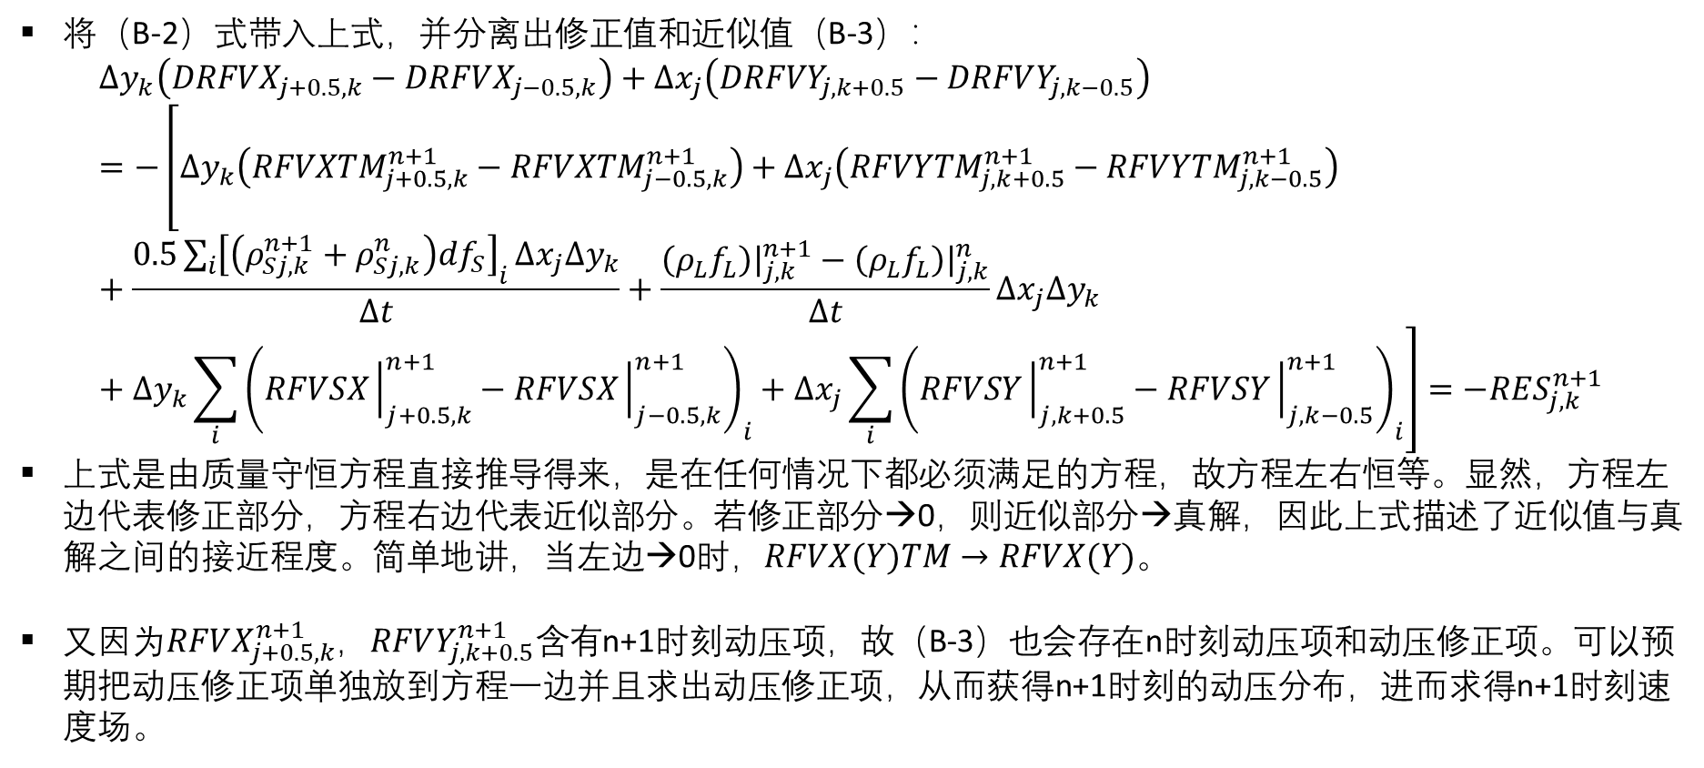
B. $P−\overset{⃑}{v}$ 求解算法（徐）
将（B-2）式带入上式，并分离出修正值和近似值（B-3）：
$$∆y_{k}\left(DRFVX_{j+0.5,k}−DRFVX_{j−0.5,k}\right)+∆x_{j}\left(DRFVY_{j,k+0.5}−DRFVY_{j,k−0.5}\right)=−\left[∆y_{k}\left(RFVXTM_{j+0.5,k}^{n+1}−RFVXTM_{j−0.5,k}^{n+1}\right)+∆x_{j}\left(RFVYTM_{j,k+0.5}^{n+1}−RFVYTM_{j,k−0.5}^{n+1}\right)+\frac{0.5\sum_{i}{{\left[\left(ρ_{Sj,k}^{n+1}+ρ_{Sj,k}^{n}\right)df_{S}\right]}_{i}}∆x_{j}∆y_{k}}{∆t}+\frac{\left(ρ_{L}f_{L}\right){\left.​\right|}_{j,k}^{n+1}−\left(ρ_{L}f_{L}\right){\left.​\right|}_{j,k}^{n}}{∆t}∆x_{j}∆y_{k}+∆y_{k}\sum_{i}{{\left(RFVSX{\left.​\right|}_{j+0.5,k}^{n+1}−RFVSX{\left.​\right|}_{j−0.5,k}^{n+1}\right)}_{i}}+∆x_{j}\sum_{i}{{\left(RFVSY{\left.​\right|}_{j,k+0.5}^{n+1}−RFVSY{\left.​\right|}_{j,k−0.5}^{n+1}\right)}_{i}}\right]=−RES_{j,k}^{n+1}$$
上式是由质量守恒方程直接推导得来，是在任何情况下都必须满足的方程，故方程左右恒等。显然，方程左边代表修正部分，方程右边代表近似部分。若修正部分→0，则近似部分→真解，因此上式描述了近似值与真解之间的接近程度。简单地讲，当左边→0时，$RFVX(Y)TM→RFVX(Y)$。
又因为$RFVX_{j+0.5,k}^{n+1}$，$RFVY_{j,k+0.5}^{n+1}含有$n+1时刻动压项，故（B-3）也会存在n时刻动压项和动压修正项。可以预期把动压修正项单独放到方程一边并且求出动压修正项，从而获得n+1时刻的动压分布，进而求得n+1时刻速度场。

Slide 21

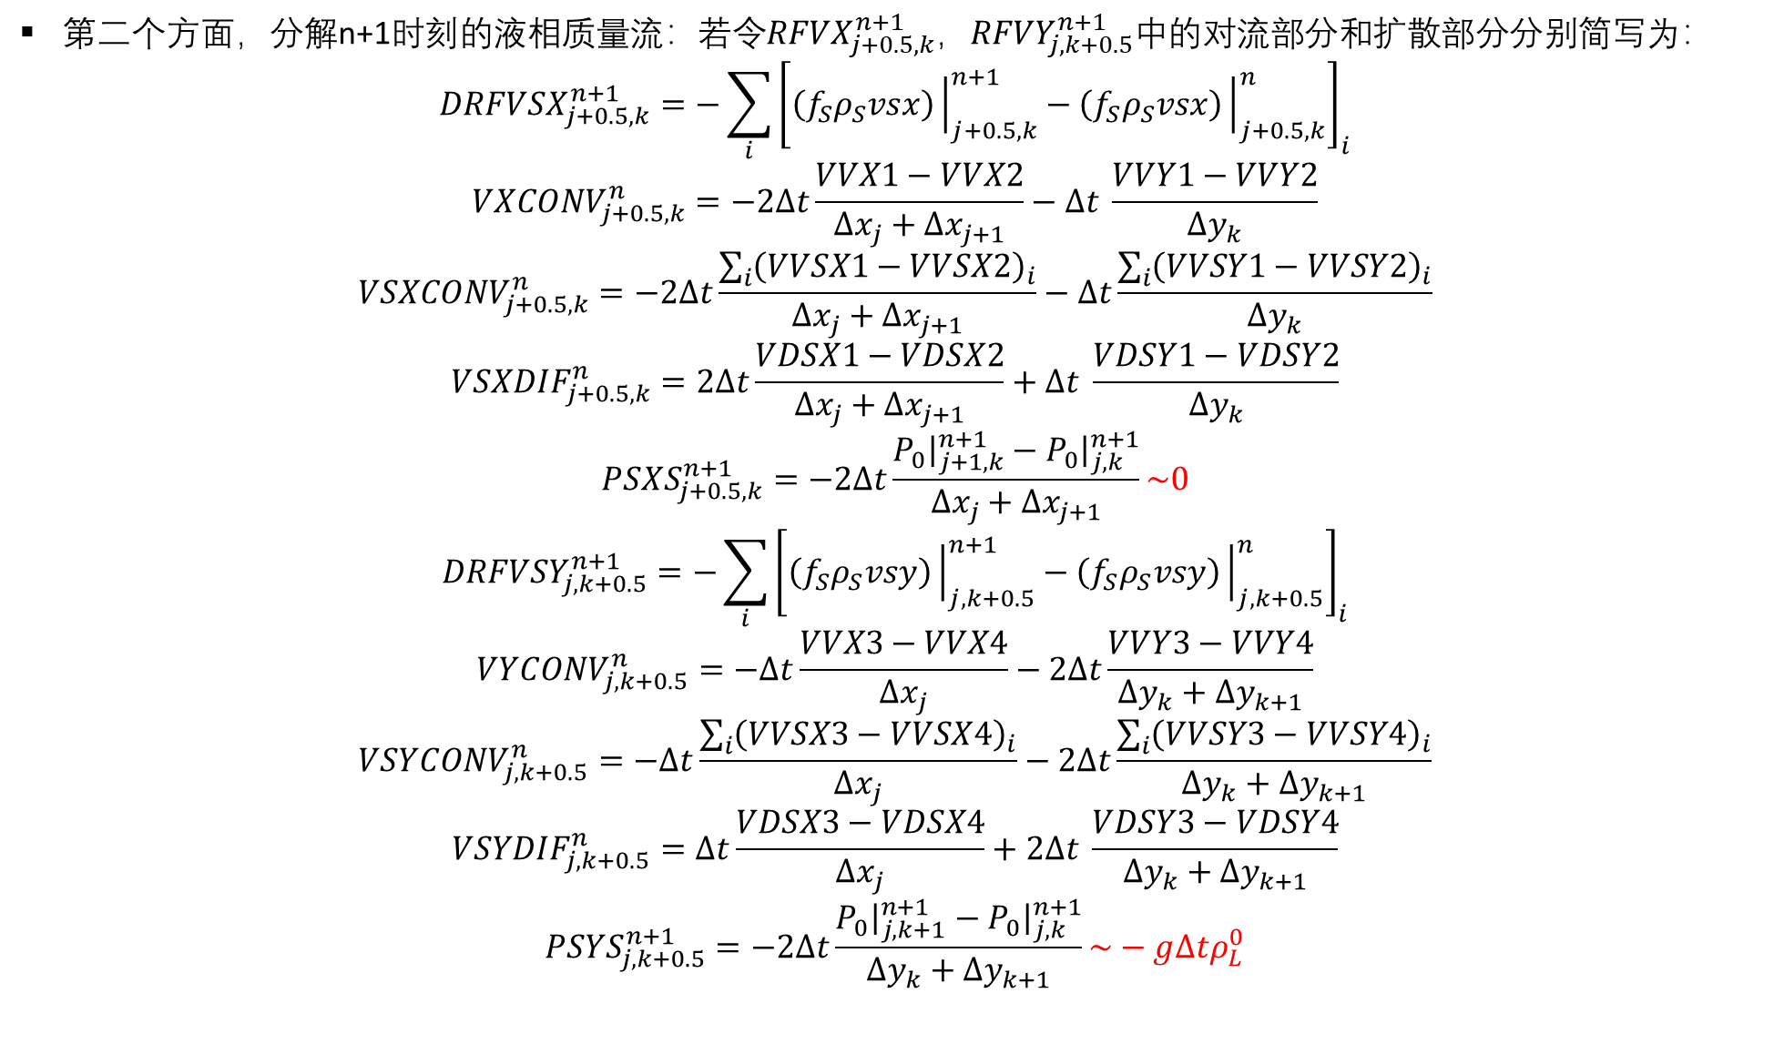
B. $P−\overset{⃑}{v}$ 求解算法（徐）
第二个方面，分解n+1时刻的液相质量流：若令$RFVX_{j+0.5,k}^{n+1}$，$RFVY_{j,k+0.5}^{n+1}$中的对流部分和扩散部分分别简写为：
$$DRFVSX_{j+0.5,k}^{n+1}=−\sum_{i}{{\left[\left(f_{S}ρ_{S}vsx\right){\left.​\right|}_{j+0.5,k}^{n+1}−\left(f_{S}ρ_{S}vsx\right){\left.​\right|}_{j+0.5,k}^{n}\right]}_{i}}$$
$$VXCONV_{j+0.5,k}^{n}=−2∆t\frac{VVX1−VVX2}{∆x_{j}+∆x_{j+1}}−∆t \frac{VVY1−VVY2}{∆y_{k}}$$
$$VSXCONV_{j+0.5,k}^{n}=−2∆t\frac{\sum_{i}{{\left(VVSX1−VVSX2\right)}_{i}}}{∆x_{j}+∆x_{j+1}}−∆t\frac{\sum_{i}{{\left(VVSY1−VVSY2\right)}_{i}}}{∆y_{k}}$$
$$VSXDIF_{j+0.5,k}^{n}=2∆t\frac{VDSX1−VDSX2}{∆x_{j}+∆x_{j+1}}+∆t \frac{VDSY1−VDSY2}{∆y_{k}}$$
$$PS{XS}_{j+0.5,k}^{n+1}=−2∆t\frac{P_{0}{\left.​\right|}_{j+1,k}^{n+1}−P_{0}{\left.​\right|}_{j,k}^{n+1}}{∆x_{j}+∆x_{j+1}}\sim 0$$
$$DRFVSY_{j,k+0.5}^{n+1}=−\sum_{i}{{\left[\left(f_{S}ρ_{S}vsy\right){\left.​\right|}_{j,k+0.5}^{n+1}−\left(f_{S}ρ_{S}vsy\right){\left.​\right|}_{j,k+0.5}^{n}\right]}_{i}}$$
$$VYCONV_{j,k+0.5}^{n}=−∆t\frac{VVX3−VVX4}{∆x_{j}}−2∆t\frac{VVY3−VVY4}{∆y_{k}+∆y_{k+1}}$$
$$VSYCONV_{j,k+0.5}^{n}=−∆t\frac{\sum_{i}{{\left(VVSX3−VVSX4\right)}_{i}}}{∆x_{j}}−2∆t\frac{\sum_{i}{{\left(VVSY3−VVSY4\right)}_{i}}}{∆y_{k}+∆y_{k+1}}$$
$$VSYDIF_{j,k+0.5}^{n}=∆t\frac{VDSX3−VDSX4}{∆x_{j}}+2∆t \frac{VDSY3−VDSY4}{∆y_{k}+∆y_{k+1}}$$
$$PS{YS}_{j,k+0.5}^{n+1}=−2∆t\frac{P_{0}{\left.​\right|}_{j,k+1}^{n+1}−P_{0}{\left.​\right|}_{j,k}^{n+1}}{∆y_{k}+∆y_{k+1}}\sim −g∆tρ_{L}^{0}$$
经过验证，PSXS，PSYS是正确的，需要编入程序；在徐达鸣的文章中并没有直接写明这两项，而只是提到扣除静压力。
Notes:
注意：（1）PSXS: x-axis static pressure for solid move；（2）PSYS的近似有前提，查看P.6；（3）PSXS和PSYS近似已标红

Slide 22
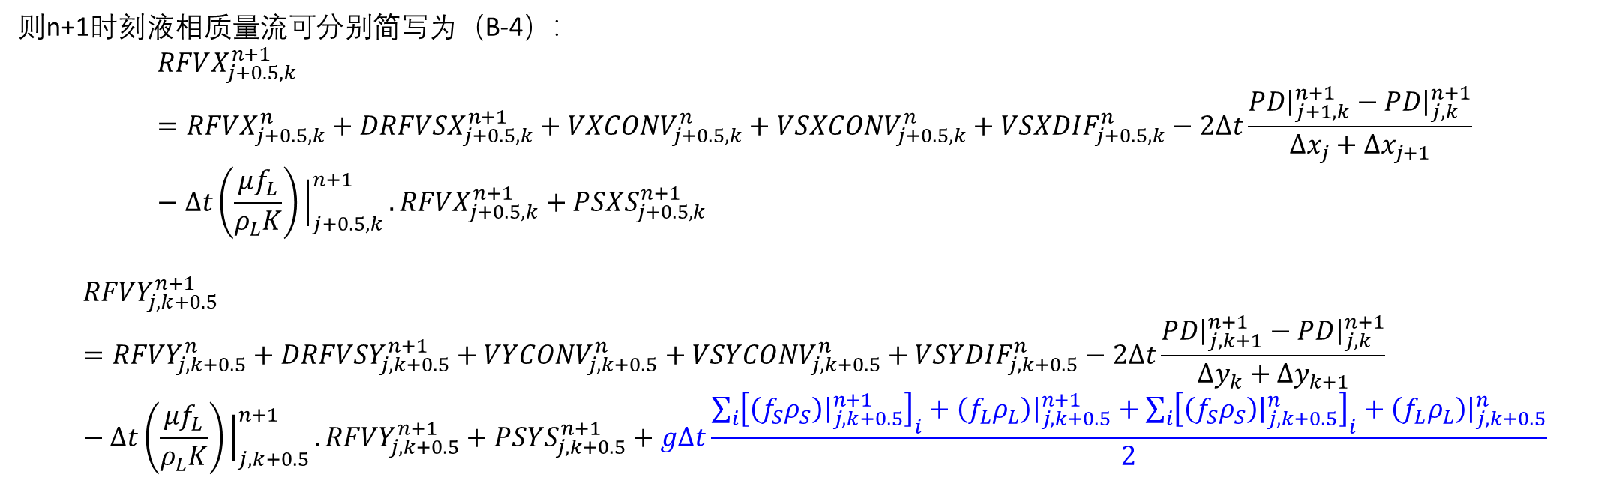
B. $P−\overset{⃑}{v}$ 求解算法（徐）
则n+1时刻液相质量流可分别简写为（B-4）：
$$RFVX_{j+0.5,k}^{n+1}=RFVX_{j+0.5,k}^{n}+DRFVSX_{j+0.5,k}^{n+1}+VXCONV_{j+0.5,k}^{n}+VSXCONV_{j+0.5,k}^{n}+VSXDIF_{j+0.5,k}^{n}−2∆t\frac{PD{\left.​\right|}_{j+1,k}^{n+1}−PD{\left.​\right|}_{j,k}^{n+1}}{∆x_{j}+∆x_{j+1}}−∆t\left(\frac{μf_{L}}{ρ_{L}K}\right){\left.​\right|}_{j+0.5,k}^{n+1}.RFVX_{j+0.5,k}^{n+1}+PS{XS}_{j+0.5,k}^{n+1}$$
$$RFVY_{j,k+0.5}^{n+1}=RFVY_{j,k+0.5}^{n}+DRFVSY_{j,k+0.5}^{n+1}+VYCONV_{j,k+0.5}^{n}+VSYCONV_{j,k+0.5}^{n}+VSYDIF_{j,k+0.5}^{n}−2∆t\frac{PD{\left.​\right|}_{j,k+1}^{n+1}−PD{\left.​\right|}_{j,k}^{n+1}}{∆y_{k}+∆y_{k+1}}−∆t\left(\frac{μf_{L}}{ρ_{L}K}\right){\left.​\right|}_{j,k+0.5}^{n+1}.RFVY_{j,k+0.5}^{n+1}+PS{YS}_{j,k+0.5}^{n+1}+g∆t\frac{\sum_{i}{{\left[\left(f_{S}ρ_{S}\right){\left.​\right|}_{j,k+0.5}^{n+1}\right]}_{i}+\left(f_{L}ρ_{L}\right){\left.​\right|}_{j,k+0.5}^{n+1}+\sum_{i}{{\left[\left(f_{S}ρ_{S}\right){\left.​\right|}_{j,k+0.5}^{n}\right]}_{i}}+\left(f_{L}ρ_{L}\right){\left.​\right|}_{j,k+0.5}^{n}}}{2}$$

Slide 23
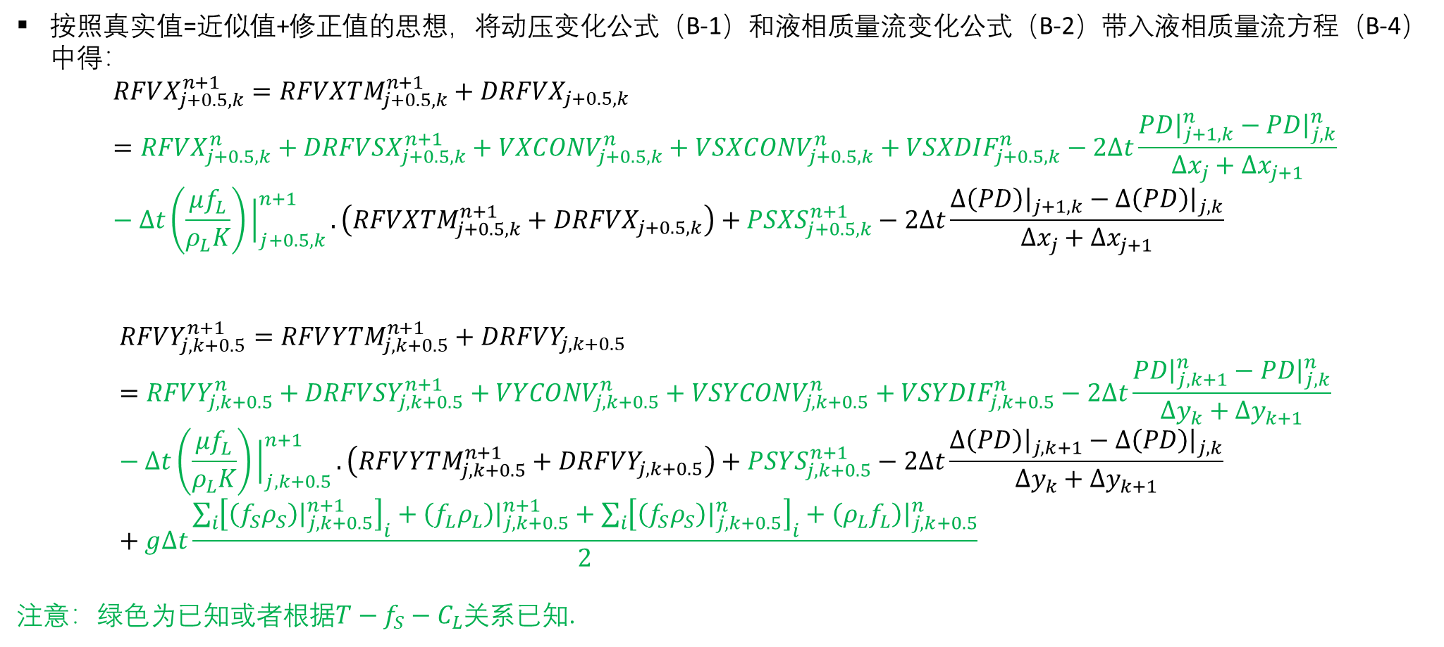
B. $P−\overset{⃑}{v}$ 求解算法（徐）
按照真实值=近似值+修正值的思想，将动压变化公式（B-1）和液相质量流变化公式（B-2）带入液相质量流方程（B-4）中得：
$$RFVX_{j+0.5,k}^{n+1}=RFV{XTM}_{j+0.5,k}^{n+1}+DRFVX_{j+0.5,k}=RFVX_{j+0.5,k}^{n}+DRFVSX_{j+0.5,k}^{n+1}+VXCONV_{j+0.5,k}^{n}+VSXCONV_{j+0.5,k}^{n}+VSXDIF_{j+0.5,k}^{n}−2∆t\frac{PD{\left.​\right|}_{j+1,k}^{n}−PD{\left.​\right|}_{j,k}^{n}}{∆x_{j}+∆x_{j+1}}−∆t\left(\frac{μf_{L}}{ρ_{L}K}\right){\left.​\right|}_{j+0.5,k}^{n+1}.\left(RFV{XTM}_{j+0.5,k}^{n+1}+DRFVX_{j+0.5,k}\right)+PSXS_{j+0.5,k}^{n+1}−2∆t\frac{∆\left(PD\right){\left.​\right|}_{j+1,k}−∆\left(PD\right){\left.​\right|}_{j,k}}{∆x_{j}+∆x_{j+1}}$$
$$RFVY_{j,k+0.5}^{n+1}=RFV{YTM}_{j,k+0.5}^{n+1}+DRFVY_{j,k+0.5}=RFVY_{j,k+0.5}^{n}+DRFVSY_{j,k+0.5}^{n+1}+VYCONV_{j,k+0.5}^{n}+VSYCONV_{j,k+0.5}^{n}+VSYDIF_{j,k+0.5}^{n}−2∆t\frac{PD{\left.​\right|}_{j,k+1}^{n}−PD{\left.​\right|}_{j,k}^{n}}{∆y_{k}+∆y_{k+1}}−∆t\left(\frac{μf_{L}}{ρ_{L}K}\right){\left.​\right|}_{j,k+0.5}^{n+1}.\left(RFV{YTM}_{j,k+0.5}^{n+1}+DRFVY_{j,k+0.5}\right)+PSYS_{j,k+0.5}^{n+1}−2∆t\frac{∆\left(PD\right){\left.​\right|}_{j,k+1}−∆\left(PD\right){\left.​\right|}_{j,k}}{∆y_{k}+∆y_{k+1}}+g∆t\frac{\sum_{i}{{\left[\left(f_{S}ρ_{S}\right){\left.​\right|}_{j,k+0.5}^{n+1}\right]}_{i}}+\left(f_{L}ρ_{L}\right){\left.​\right|}_{j,k+0.5}^{n+1}+\sum_{i}{{\left[\left(f_{S}ρ_{S}\right){\left.​\right|}_{j,k+0.5}^{n}\right]}_{i}}+\left(ρ_{L}f_{L}\right){\left.​\right|}_{j,k+0.5}^{n}}{2}$$
注意：绿色为已知或者根据$T−f_{S}−C_{L}$关系已知.

Slide 24
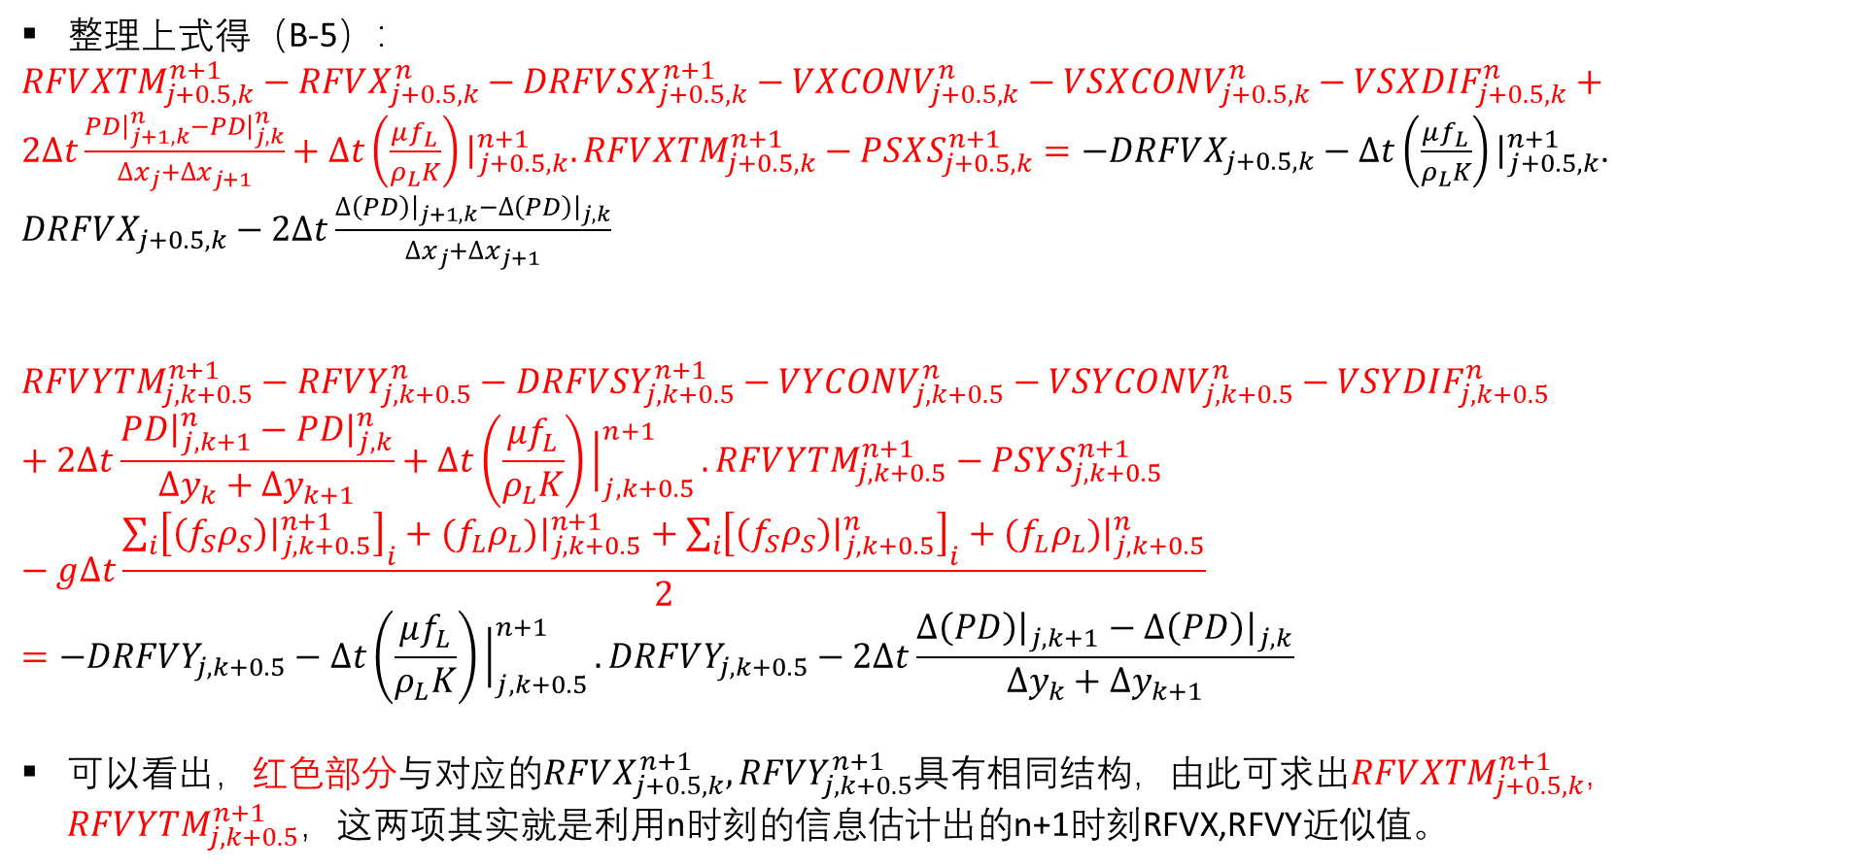
B. $P−\overset{⃑}{v}$ 求解算法（徐）
整理上式得（B-5）：
$RFV{XTM}_{j+0.5,k}^{n+1}−RFVX_{j+0.5,k}^{n}−DRFVSX_{j+0.5,k}^{n+1}−VXCONV_{j+0.5,k}^{n}−VSXCONV_{j+0.5,k}^{n}−VSXDIF_{j+0.5,k}^{n}+2∆t\frac{PD{\left.​\right|}_{j+1,k}^{n}−PD{\left.​\right|}_{j,k}^{n}}{∆x_{j}+∆x_{j+1}}+∆t\left(\frac{μf_{L}}{ρ_{L}K}\right){\left.​\right|}_{j+0.5,k}^{n+1}.RFV{XTM}_{j+0.5,k}^{n+1}−PSXS_{j+0.5,k}^{n+1}=−DRFVX_{j+0.5,k}−∆t\left(\frac{μf_{L}}{ρ_{L}K}\right){\left.​\right|}_{j+0.5,k}^{n+1}$. $DRFVX_{j+0.5,k}−2∆t\frac{∆\left(PD\right){\left.​\right|}_{j+1,k}−∆\left(PD\right){\left.​\right|}_{j,k}}{∆x_{j}+∆x_{j+1}}$
$$RFV{YTM}_{j,k+0.5}^{n+1}−RFVY_{j,k+0.5}^{n}−DRFVSY_{j,k+0.5}^{n+1}−VYCONV_{j,k+0.5}^{n}−VSYCONV_{j,k+0.5}^{n}−VSYDIF_{j,k+0.5}^{n}+2∆t\frac{PD{\left.​\right|}_{j,k+1}^{n}−PD{\left.​\right|}_{j,k}^{n}}{∆y_{k}+∆y_{k+1}}+∆t\left(\frac{μf_{L}}{ρ_{L}K}\right){\left.​\right|}_{j,k+0.5}^{n+1}.RFV{YTM}_{j,k+0.5}^{n+1}−PSYS_{j,k+0.5}^{n+1}−g∆t\frac{\sum_{i}{{\left[\left(f_{S}ρ_{S}\right){\left.​\right|}_{j,k+0.5}^{n+1}\right]}_{i}}+{(f}_{L}ρ_{L}){\left.​\right|}_{j,k+0.5}^{n+1}+\sum_{i}{{\left[\left(f_{S}ρ_{S}\right){\left.​\right|}_{j,k+0.5}^{n}\right]}_{i}}+(f_{L}ρ_{L}){\left.​\right|}_{j,k+0.5}^{n}}{2}=−DRFVY_{j,k+0.5}−∆t\left(\frac{μf_{L}}{ρ_{L}K}\right){\left.​\right|}_{j,k+0.5}^{n+1}.DRFVY_{j,k+0.5}−2∆t\frac{∆\left(PD\right){\left.​\right|}_{j,k+1}−∆\left(PD\right){\left.​\right|}_{j,k}}{∆y_{k}+∆y_{k+1}}$$
可以看出，红色部分与对应的$RFVX_{j+0.5,k}^{n+1},RFVY_{j,k+0.5}^{n+1}$具有相同结构，由此可求出$RFV{XTM}_{j+0.5,k}^{n+1}$，$RFV{YTM}_{j,k+0.5}^{n+1}$，这两项其实就是利用n时刻的信息估计出的n+1时刻RFVX,RFVY近似值。

Slide 25
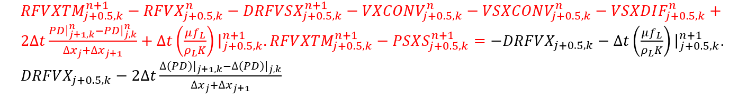
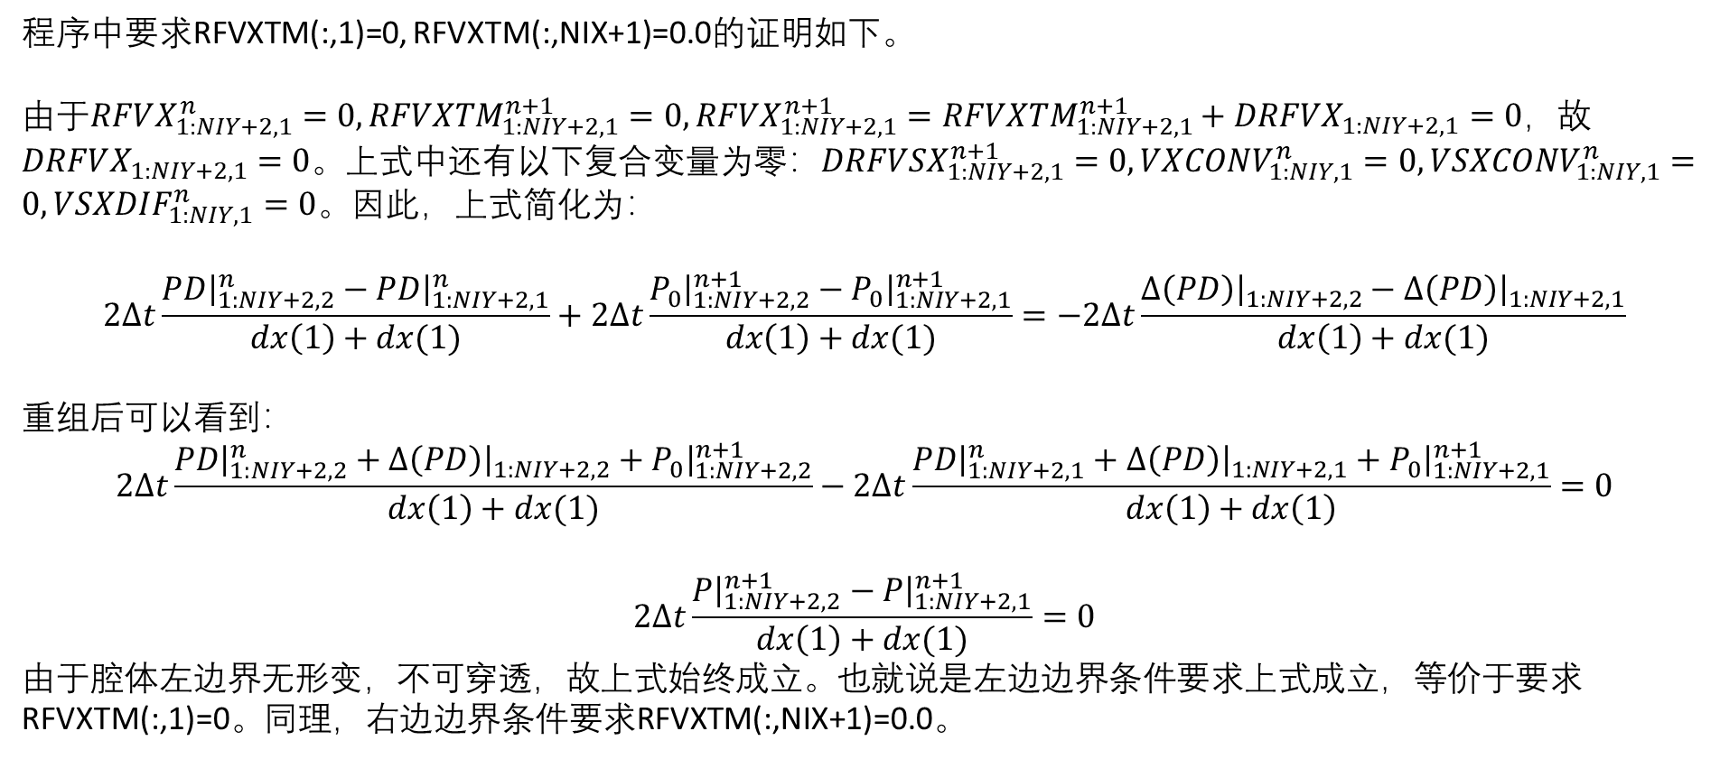
B. $P−\overset{⃑}{v}$ 求解算法（徐）
程序中要求RFVXTM(:,1)=0, RFVXTM(:,NIX+1)=0.0的证明如下。
由于$RFVX_{1:NIY+2,1}^{n}=0, RFVXTM_{1:NIY+2,1}^{n+1}=0, RFVX_{1:NIY+2,1}^{n+1}=RFV{XTM}_{1:NIY+2,1}^{n+1}+DRFVX_{1:NIY+2,1}=0，$故$DRFVX_{1:NIY+2,1}=0$。上式中还有以下复合变量为零：$DRFVSX_{1:NIY+2,1}^{n+1}=0, VXCONV_{1:NIY,1}^{n}=0, VSXCONV_{1:NIY,1}^{n}=0, VSXDIF_{1:NIY,1}^{n}=0。$因此，上式简化为：
$$2∆t\frac{PD{\left.​\right|}_{1:NIY+2,2}^{n}−PD{\left.​\right|}_{1:NIY+2,1}^{n}}{dx\left(1\right)+dx(1)}+2∆t\frac{P_{0}{\left.​\right|}_{1:NIY+2,2}^{n+1}−P_{0}{\left.​\right|}_{1:NIY+2,1}^{n+1}}{dx\left(1\right)+dx(1)}=−2∆t\frac{∆\left(PD\right){\left.​\right|}_{1:NIY+2,2}−∆\left(PD\right){\left.​\right|}_{1:NIY+2,1}}{dx\left(1\right)+dx(1)}$$
重组后可以看到：
$$2∆t\frac{PD{\left.​\right|}_{1:NIY+2,2}^{n}+∆\left(PD\right){\left.​\right|}_{1:NIY+2,2}+P_{0}{\left.​\right|}_{1:NIY+2,2}^{n+1}}{dx\left(1\right)+dx(1)}−2∆t\frac{PD{\left.​\right|}_{1:NIY+2,1}^{n}+∆\left(PD\right){\left.​\right|}_{1:NIY+2,1}+P_{0}{\left.​\right|}_{1:NIY+2,1}^{n+1}}{dx\left(1\right)+dx\left(1\right)}=0$$
$$2∆t\frac{P{\left.​\right|}_{1:NIY+2,2}^{n+1}−P{\left.​\right|}_{1:NIY+2,1}^{n+1}}{dx\left(1\right)+dx(1)}=0$$
由于腔体左边界无形变，不可穿透，故上式始终成立。也就说是左边边界条件要求上式成立，等价于要求RFVXTM(:,1)=0。同理，右边边界条件要求RFVXTM(:,NIX+1)=0.0。

Slide 26
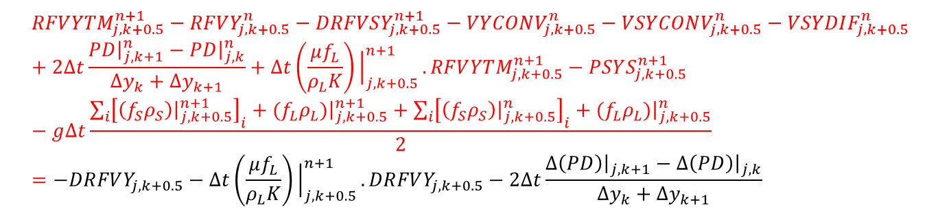
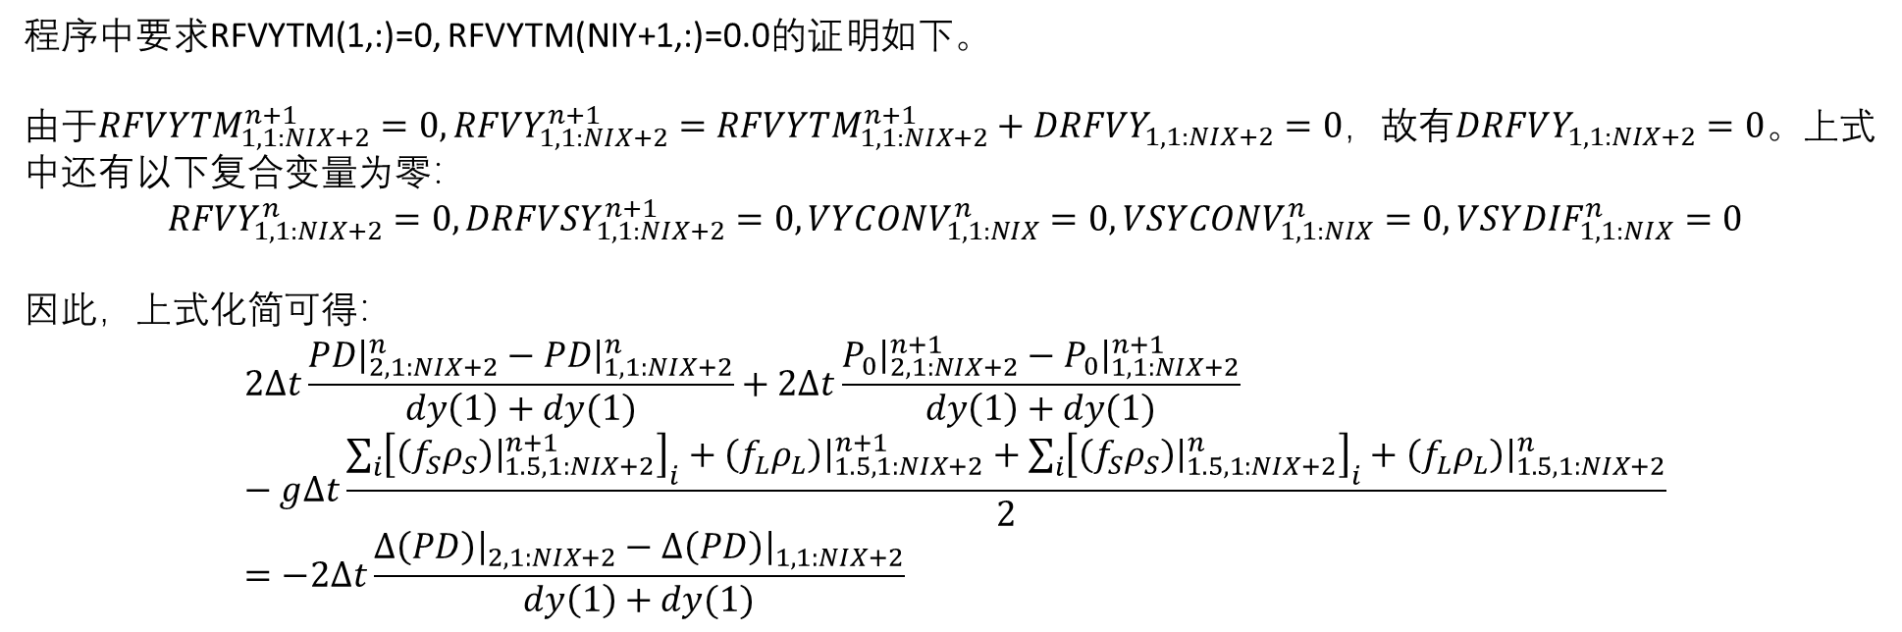
B. $P−\overset{⃑}{v}$ 求解算法（徐）
程序中要求RFVYTM(1,:)=0, RFVYTM(NIY+1,:)=0.0的证明如下。
由于$RFVYTM_{1,1:NIX+2}^{n+1}=0, RFVY_{1,1:NIX+2}^{n+1}=RFVYTM_{1,1:NIX+2}^{n+1}+DRFVY_{1,1:NIX+2}=0$，故有$DRFVY_{1,1:NIX+2}=0$。上式中还有以下复合变量为零：
$$RFVY_{1,1:NIX+2}^{n}=0, DRFVSY_{1,1:NIX+2}^{n+1}=0, VYCONV_{1,1:NIX}^{n}=0, VSYCONV_{1,1:NIX}^{n}=0, VSYDIF_{1,1:NIX}^{n}=0$$
因此，上式化简可得：
$$2∆t\frac{PD{\left.​\right|}_{2,1:NIX+2}^{n}−PD{\left.​\right|}_{1,1:NIX+2}^{n}}{dy\left(1\right)+dy(1)}+2∆t\frac{P_{0}{\left.​\right|}_{2,1:NIX+2}^{n+1}−P_{0}{\left.​\right|}_{1,1:NIX+2}^{n+1}}{dy\left(1\right)+dy(1)}−g∆t\frac{\sum_{i}{{\left[\left(f_{S}ρ_{S}\right){\left.​\right|}_{1.5,1:NIX+2}^{n+1}\right]}_{i}}+\left(f_{L}ρ_{L}\right){\left.​\right|}_{1.5,1:NIX+2}^{n+1}+\sum_{i}{{\left[\left(f_{S}ρ_{S}\right){\left.​\right|}_{1.5,1:NIX+2}^{n}\right]}_{i}}+\left(f_{L}ρ_{L}\right){\left.​\right|}_{1.5,1:NIX+2}^{n}}{2}=−2∆t\frac{∆\left(PD\right){\left.​\right|}_{2,1:NIX+2}−∆\left(PD\right){\left.​\right|}_{1,1:NIX+2}}{dy\left(1\right)+dy(1)}$$

Slide 27
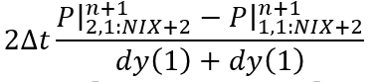
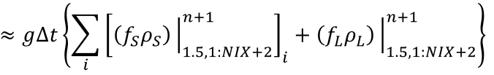
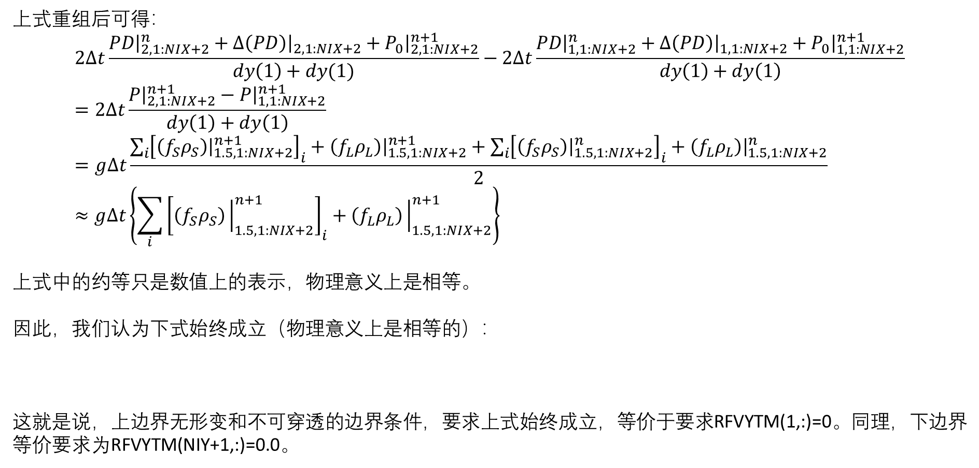
B. $P−\overset{⃑}{v}$ 求解算法（徐）
上式重组后可得：
$$2∆t\frac{PD{\left.​\right|}_{2,1:NIX+2}^{n}+∆\left(PD\right){\left.​\right|}_{2,1:NIX+2}+P_{0}{\left.​\right|}_{2,1:NIX+2}^{n+1}}{dy\left(1\right)+dy(1)}−2∆t\frac{PD{\left.​\right|}_{1,1:NIX+2}^{n}+∆\left(PD\right){\left.​\right|}_{1,1:NIX+2}+P_{0}{\left.​\right|}_{1,1:NIX+2}^{n+1}}{dy\left(1\right)+dy\left(1\right)}=2∆t\frac{P{\left.​\right|}_{2,1:NIX+2}^{n+1}−P{\left.​\right|}_{1,1:NIX+2}^{n+1}}{dy\left(1\right)+dy\left(1\right)}=g∆t\frac{\sum_{i}{{\left[\left(f_{S}ρ_{S}\right){\left.​\right|}_{1.5,1:NIX+2}^{n+1}\right]}_{i}}+\left(f_{L}ρ_{L}\right){\left.​\right|}_{1.5,1:NIX+2}^{n+1}+\sum_{i}{{\left[\left(f_{S}ρ_{S}\right){\left.​\right|}_{1.5,1:NIX+2}^{n}\right]}_{i}}+\left(f_{L}ρ_{L}\right){\left.​\right|}_{1.5,1:NIX+2}^{n}}{2}≈g∆t\left\{\sum_{i}{{\left[\left(f_{S}ρ_{S}\right){\left.​\right|}_{1.5,1:NIX+2}^{n+1}\right]}_{i}}+\left(f_{L}ρ_{L}\right){\left.​\right|}_{1.5,1:NIX+2}^{n+1}\right\}$$
上式中的约等只是数值上的表示，物理意义上是相等。
因此，我们认为下式始终成立（物理意义上是相等的）：
这就是说，上边界无形变和不可穿透的边界条件，要求上式始终成立，等价于要求RFVYTM(1,:)=0。同理，下边界等价要求为RFVYTM(NIY+1,:)=0.0。

Slide 28
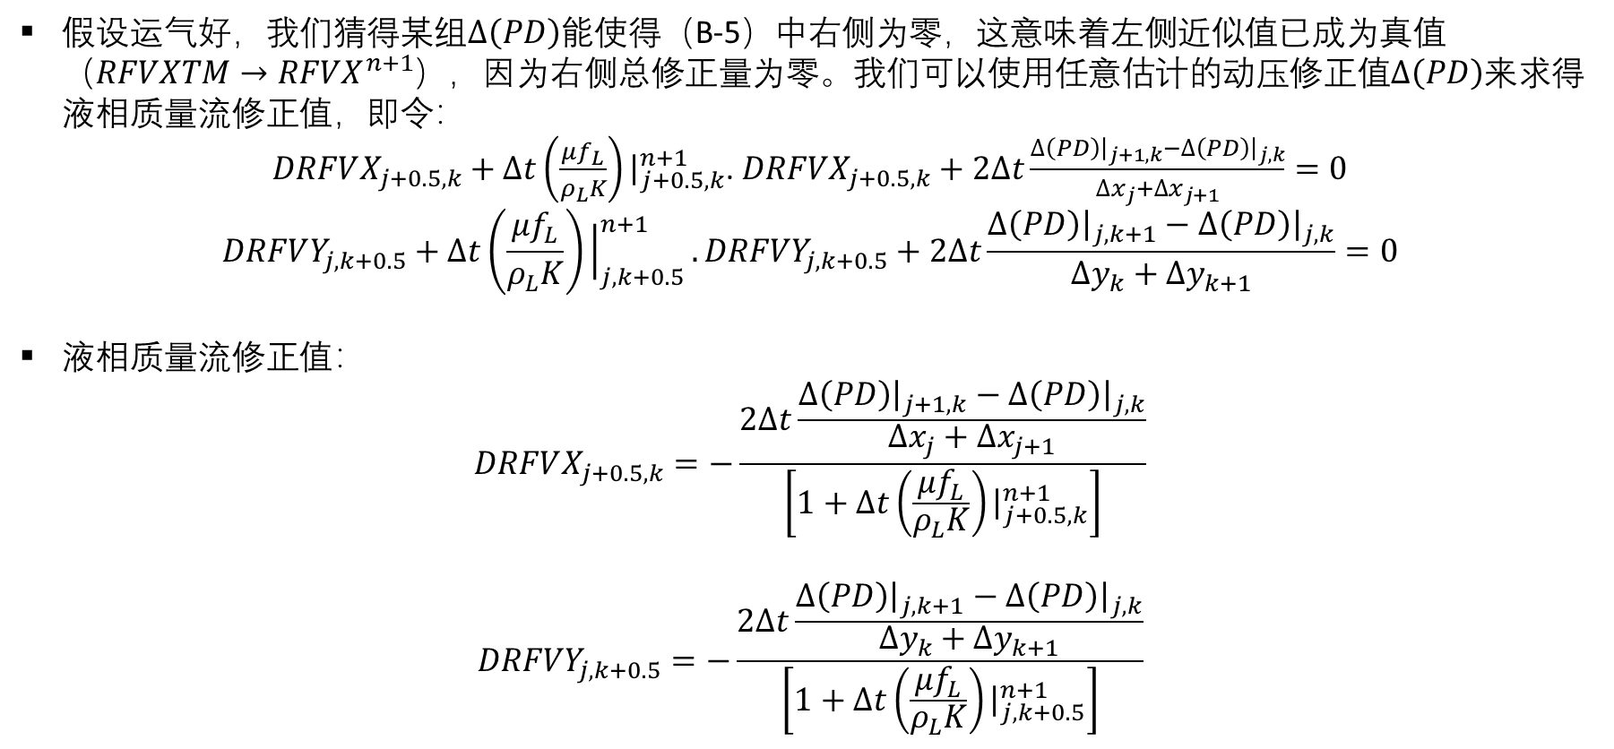
B. $P−\overset{⃑}{v}$ 求解算法（徐）
假设运气好，我们猜得某组$∆\left(PD\right)$能使得（B-5）中右侧为零，这意味着左侧近似值已成为真值（$RFVXTM→RFVX^{n+1}$），因为右侧总修正量为零。我们可以使用任意估计的动压修正值$∆\left(PD\right)$来求得液相质量流修正值，即令：
$DRFVX_{j+0.5,k}+∆t\left(\frac{μf_{L}}{ρ_{L}K}\right){\left.​\right|}_{j+0.5,k}^{n+1}$. $DRFVX_{j+0.5,k}+2∆t\frac{∆\left(PD\right){\left.​\right|}_{j+1,k}−∆\left(PD\right){\left.​\right|}_{j,k}}{∆x_{j}+∆x_{j+1}}=0$
$$DRFVY_{j,k+0.5}+∆t\left(\frac{μf_{L}}{ρ_{L}K}\right){\left.​\right|}_{j,k+0.5}^{n+1}.DRFVY_{j,k+0.5}+2∆t\frac{∆\left(PD\right){\left.​\right|}_{j,k+1}−∆\left(PD\right){\left.​\right|}_{j,k}}{∆y_{k}+∆y_{k+1}}=0$$
液相质量流修正值：
$$DRFVX_{j+0.5,k}=−\frac{2∆t\frac{∆\left(PD\right){\left.​\right|}_{j+1,k}−∆\left(PD\right){\left.​\right|}_{j,k}}{∆x_{j}+∆x_{j+1}}}{\left[1+∆t\left(\frac{μf_{L}}{ρ_{L}K}\right){\left.​\right|}_{j+0.5,k}^{n+1}\right]}$$
$$DRFVY_{j,k+0.5}=−\frac{2∆t\frac{∆\left(PD\right){\left.​\right|}_{j,k+1}−∆\left(PD\right){\left.​\right|}_{j,k}}{∆y_{k}+∆y_{k+1}}}{\left[1+∆t\left(\frac{μf_{L}}{ρ_{L}K}\right){\left.​\right|}_{j,k+0.5}^{n+1}\right]}$$

Slide 29
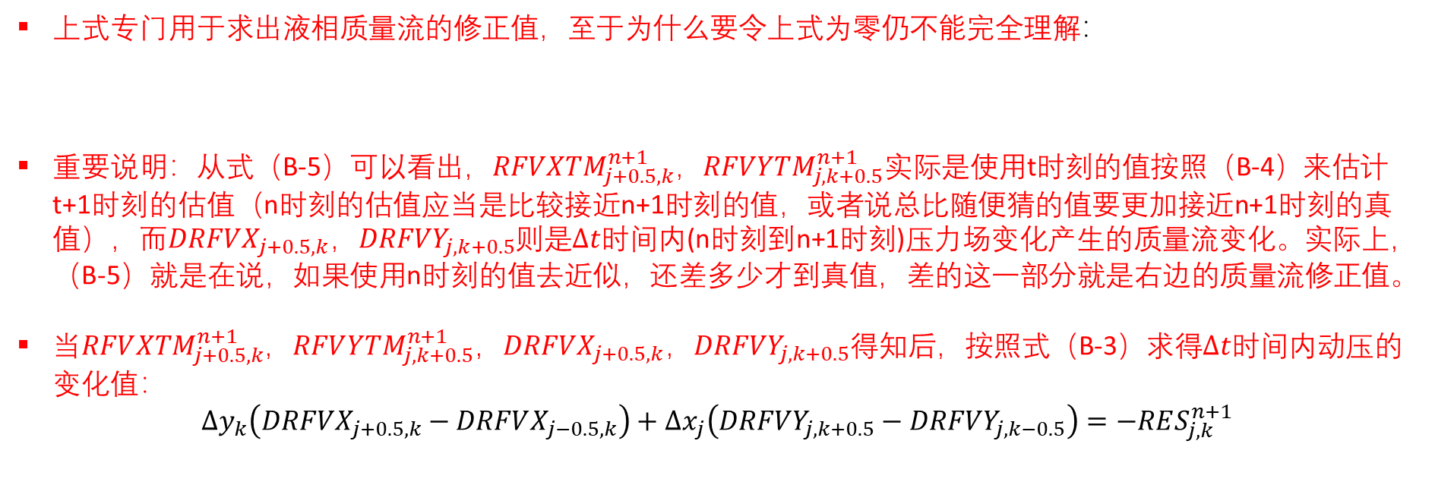
B. $P−\overset{⃑}{v}$ 求解算法（徐）
上式专门用于求出液相质量流的修正值，至于为什么要令上式为零仍不能完全理解：
重要说明：从式（B-5）可以看出，$RFV{XTM}_{j+0.5,k}^{n+1}$，$RFV{YTM}_{j,k+0.5}^{n+1}$实际是使用t时刻的值按照（B-4）来估计t+1时刻的估值（n时刻的估值应当是比较接近n+1时刻的值，或者说总比随便猜的值要更加接近n+1时刻的真值），而$DRFVX_{j+0.5,k}$，$DRFVY_{j,k+0.5}$则是$∆t$时间内(n时刻到n+1时刻)压力场变化产生的质量流变化。实际上，（B-5）就是在说，如果使用n时刻的值去近似，还差多少才到真值，差的这一部分就是右边的质量流修正值。
当$RFV{XTM}_{j+0.5,k}^{n+1}$，$RFV{YTM}_{j,k+0.5}^{n+1}$，$DRFVX_{j+0.5,k}$，$DRFVY_{j,k+0.5}$得知后，按照式（B-3）求得$∆t$时间内动压的变化值：
$$∆y_{k}\left(DRFVX_{j+0.5,k}−DRFVX_{j−0.5,k}\right)+∆x_{j}\left(DRFVY_{j,k+0.5}−DRFVY_{j,k−0.5}\right)=−RES_{j,k}^{n+1}$$

Slide 30
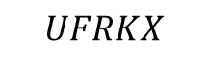

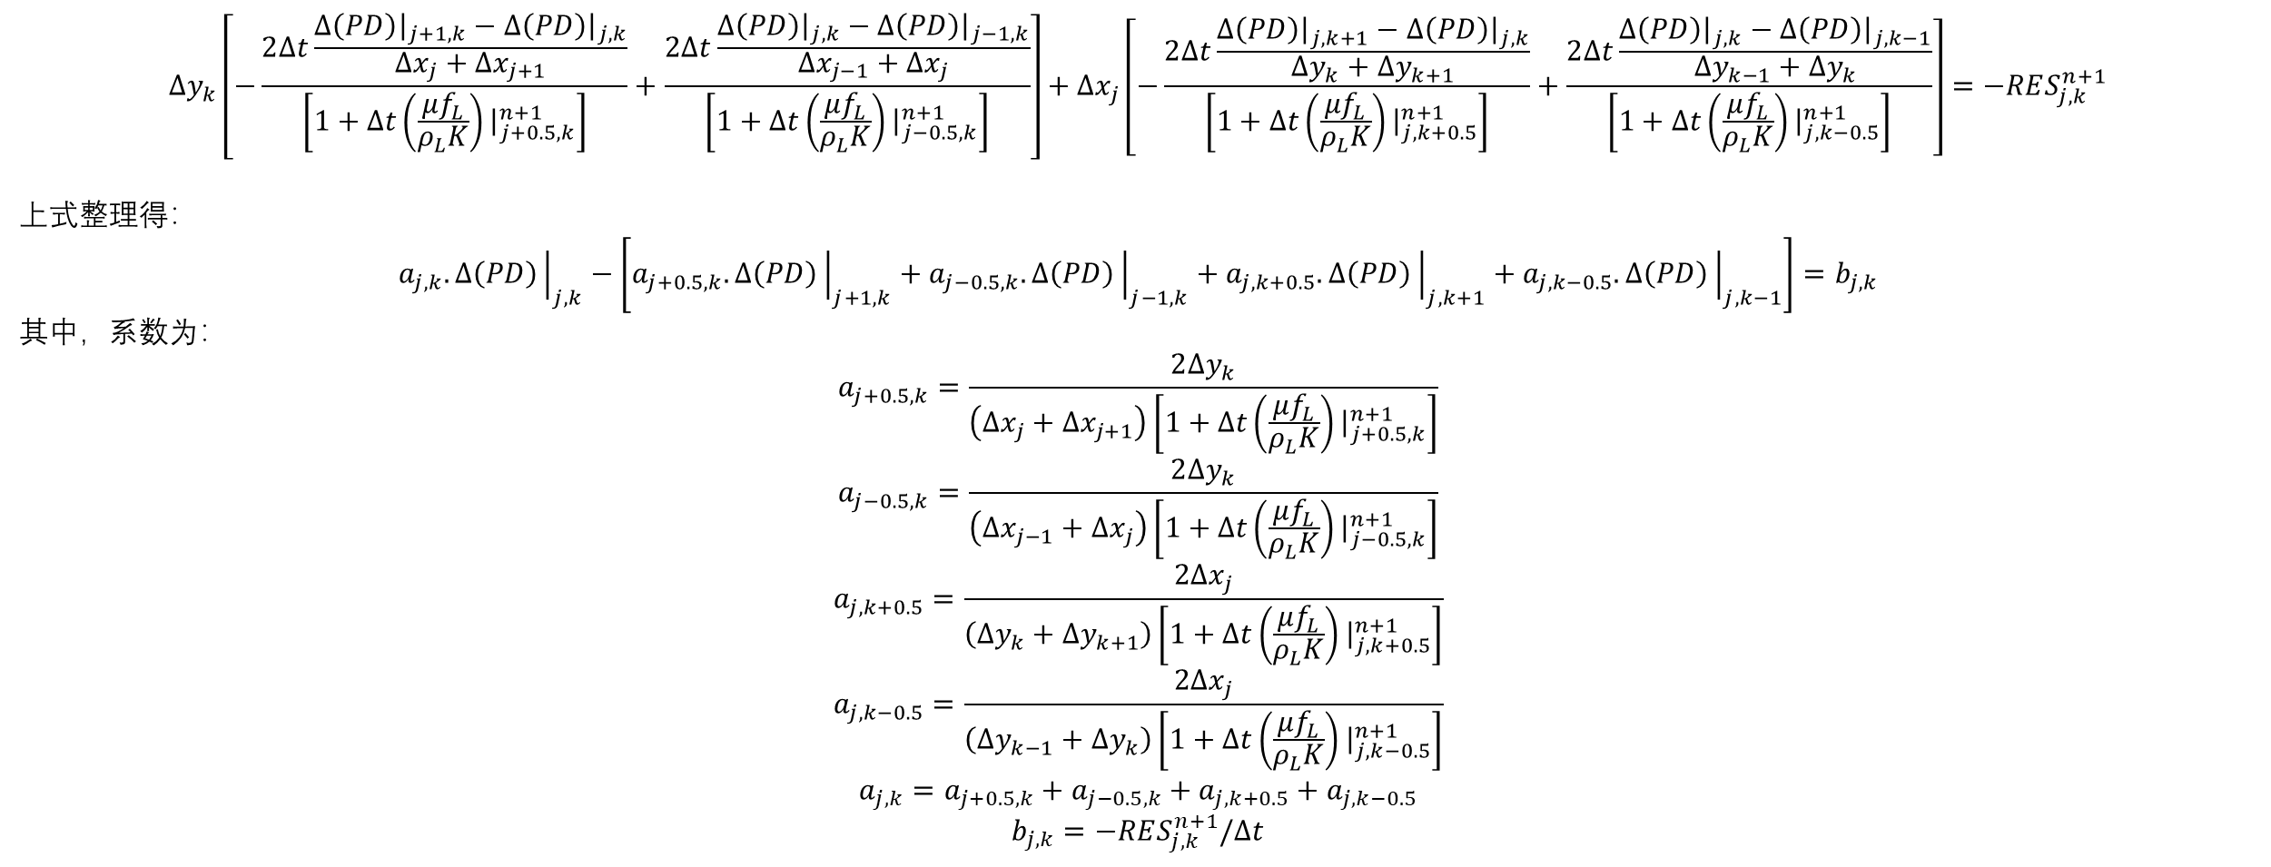
B. $P−\overset{⃑}{v}$ 求解算法（徐）
$$∆y_{k}\left[−\frac{2∆t\frac{∆\left(PD\right){\left.​\right|}_{j+1,k}−∆\left(PD\right){\left.​\right|}_{j,k}}{∆x_{j}+∆x_{j+1}}}{\left[1+∆t\left(\frac{μf_{L}}{ρ_{L}K}\right){\left.​\right|}_{j+0.5,k}^{n+1}\right]}+\frac{2∆t\frac{∆\left(PD\right){\left.​\right|}_{j,k}−∆\left(PD\right){\left.​\right|}_{j−1,k}}{∆x_{j−1}+∆x_{j}}}{\left[1+∆t\left(\frac{μf_{L}}{ρ_{L}K}\right){\left.​\right|}_{j−0.5,k}^{n+1}\right]}\right]+∆x_{j}\left[−\frac{2∆t\frac{∆\left(PD\right){\left.​\right|}_{j,k+1}−∆\left(PD\right){\left.​\right|}_{j,k}}{∆y_{k}+∆y_{k+1}}}{\left[1+∆t\left(\frac{μf_{L}}{ρ_{L}K}\right){\left.​\right|}_{j,k+0.5}^{n+1}\right]}+\frac{2∆t\frac{∆\left(PD\right){\left.​\right|}_{j,k}−∆\left(PD\right){\left.​\right|}_{j,k−1}}{∆y_{k−1}+∆y_{k}}}{\left[1+∆t\left(\frac{μf_{L}}{ρ_{L}K}\right){\left.​\right|}_{j,k−0.5}^{n+1}\right]}\right]=−RES_{j,k}^{n+1}$$
上式整理得：
$$a_{j,k}.∆\left(PD\right){\left.​\right|}_{j,k}−\left[a_{j+0.5,k}.∆\left(PD\right){\left.​\right|}_{j+1,k}+a_{j−0.5,k}.∆\left(PD\right){\left.​\right|}_{j−1,k}+a_{j,k+0.5}.∆\left(PD\right){\left.​\right|}_{j,k+1}+a_{j,k−0.5}.∆\left(PD\right){\left.​\right|}_{j,k−1}\right]=b_{j,k}$$
其中，系数为：
$$a_{j+0.5,k}=\frac{2∆y_{k}}{\left(∆x_{j}+∆x_{j+1}\right)\left[1+∆t\left(\frac{μf_{L}}{ρ_{L}K}\right){\left.​\right|}_{j+0.5,k}^{n+1}\right]}$$
$$a_{j−0.5,k}=\frac{2∆y_{k}}{\left(∆x_{j−1}+∆x_{j}\right)\left[1+∆t\left(\frac{μf_{L}}{ρ_{L}K}\right){\left.​\right|}_{j−0.5,k}^{n+1}\right]}$$
$$a_{j,k+0.5}=\frac{2∆x_{j}}{\left(∆y_{k}+∆y_{k+1}\right)\left[1+∆t\left(\frac{μf_{L}}{ρ_{L}K}\right){\left.​\right|}_{j,k+0.5}^{n+1}\right]}$$
$$a_{j,k−0.5}=\frac{2∆x_{j}}{\left(∆y_{k−1}+∆y_{k}\right)\left[1+∆t\left(\frac{μf_{L}}{ρ_{L}K}\right){\left.​\right|}_{j,k−0.5}^{n+1}\right]}$$
$$a_{j,k}=a_{j+0.5,k}+a_{j−0.5,k}+a_{j,k+0.5}+a_{j,k−0.5}$$
$$b_{j,k}=−RES_{j,k}^{n+1}/∆t$$
$$UFRKX$$
$$UFRKY$$
Notes:
注意：压力需要减去初始压力，提高计算精度

Slide 31
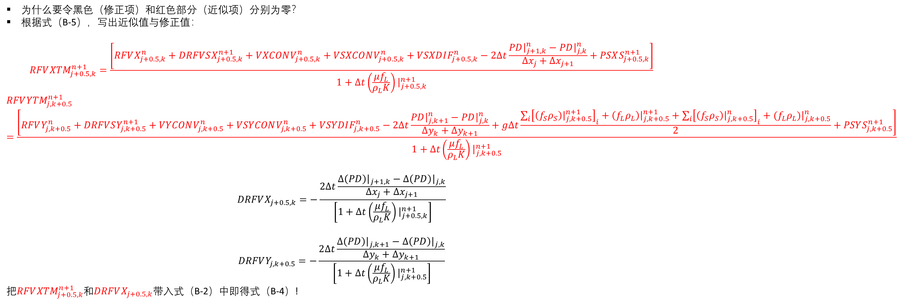
B. $P−\overset{⃑}{v}$ 求解算法（徐）
为什么要令黑色（修正项）和红色部分（近似项）分别为零？
根据式（B-5），写出近似值与修正值：
$$RFV{XTM}_{j+0.5,k}^{n+1}=\frac{\left[RFVX_{j+0.5,k}^{n}+DRFVSX_{j+0.5,k}^{n+1}+VXCONV_{j+0.5,k}^{n}+VSXCONV_{j+0.5,k}^{n}+VSXDIF_{j+0.5,k}^{n}−2∆t\frac{PD{\left.​\right|}_{j+1,k}^{n}−PD{\left.​\right|}_{j,k}^{n}}{∆x_{j}+∆x_{j+1}}+PSXS_{j+0.5,k}^{n+1}\right]}{1+∆t\left(\frac{μf_{L}}{ρ_{L}K}\right){\left.​\right|}_{j+0.5,k}^{n+1}}$$
$$RFV{YTM}_{j,k+0.5}^{n+1}=\frac{\left[RFVY_{j,k+0.5}^{n}+DRFVSY_{j,k+0.5}^{n+1}+VYCONV_{j,k+0.5}^{n}+VSYCONV_{j,k+0.5}^{n}+VSYDIF_{j,k+0.5}^{n}−2∆t\frac{PD{\left.​\right|}_{j,k+1}^{n}−PD{\left.​\right|}_{j,k}^{n}}{∆y_{k}+∆y_{k+1}}+g∆t\frac{\sum_{i}{{\left[\left(f_{S}ρ_{S}\right){\left.​\right|}_{j,k+0.5}^{n+1}\right]}_{i}}+\left(f_{L}ρ_{L}\right){\left.​\right|}_{j,k+0.5}^{n+1}+\sum_{i}{{\left[\left(f_{S}ρ_{S}\right){\left.​\right|}_{j,k+0.5}^{n}\right]}_{i}}+{(f}_{L}ρ_{L}){\left.​\right|}_{j,k+0.5}^{n}}{2}+PSYS_{j,k+0.5}^{n+1}\right]}{1+∆t\left(\frac{μf_{L}}{ρ_{L}K}\right){\left.​\right|}_{j,k+0.5}^{n+1}}$$
$$DRFVX_{j+0.5,k}=−\frac{2∆t\frac{∆\left(PD\right){\left.​\right|}_{j+1,k}−∆\left(PD\right){\left.​\right|}_{j,k}}{∆x_{j}+∆x_{j+1}}}{\left[1+∆t\left(\frac{μf_{L}}{ρ_{L}K}\right){\left.​\right|}_{j+0.5,k}^{n+1}\right]}$$
$$DRFVY_{j,k+0.5}=−\frac{2∆t\frac{∆\left(PD\right){\left.​\right|}_{j,k+1}−∆\left(PD\right){\left.​\right|}_{j,k}}{∆y_{k}+∆y_{k+1}}}{\left[1+∆t\left(\frac{μf_{L}}{ρ_{L}K}\right){\left.​\right|}_{j,k+0.5}^{n+1}\right]}$$
把$RFV{XTM}_{j+0.5,k}^{n+1}$和$DRFVX_{j+0.5,k}$带入式（B-2）中即得式（B-4）!

Slide 32
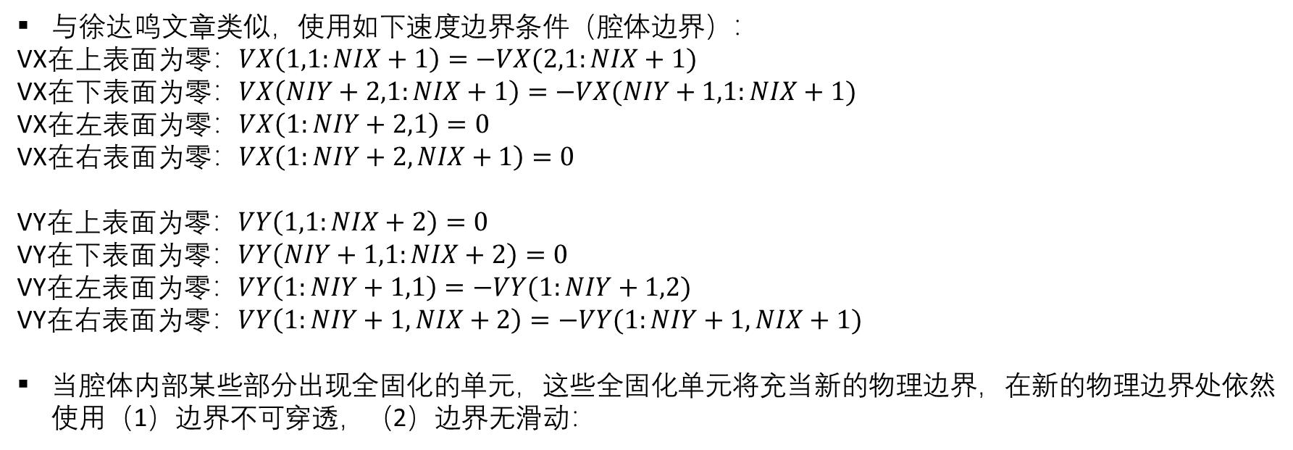
B. $P−\overset{⃑}{v}$ 求解算法（徐）
与徐达鸣文章类似，使用如下速度边界条件（腔体边界）：
VX在上表面为零：$VX\left(1,1:NIX+1\right)=−VX(2,1:NIX+1)$
VX在下表面为零：$VX\left(NIY+2,1:NIX+1\right)=−VX(NIY+1,1:NIX+1)$
VX在左表面为零：$VX\left(1:NIY+2,1\right)=0$
VX在右表面为零：$VX\left(1:NIY+2,NIX+1\right)=0$
VY在上表面为零：$VY\left(1,1:NIX+2\right)=0$
VY在下表面为零：$VY\left(NIY+1,1:NIX+2\right)=0$
VY在左表面为零：$VY\left(1:NIY+1,1\right)=−VY(1:NIY+1,2)$
VY在右表面为零：$VY\left(1:NIY+1,NIX+2\right)=−VY(1:NIY+1,NIX+1)$
当腔体内部某些部分出现全固化的单元，这些全固化单元将充当新的物理边界，在新的物理边界处依然使用（1）边界不可穿透，（2）边界无滑动：

Slide 33

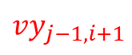
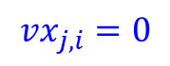
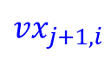













B. $P−\overset{⃑}{v}$ 求解算法（徐）
i
$$vx_{j,i}=0$$
$$vy_{j−1,i}$$
j
$$vy_{j−1,i}$$
$$vy_{j−1,i+1}$$
$$vx_{j,i−1}$$
(j,i)
(j+1,i)
$$vx_{j,i}$$
$vx_{j,i−1}$
$$vx_{j,i+1}$$
$$vy_{j,i}=0$$
(j,i) (j,i+1)
$$vx_{j+1,i−1}$$
$$vx_{j+1,i}$$
$$vy_{j,i}$$
$$vy_{j,i+1}$$
$$vy_{j+1,i}$$
左侧不可穿透：
$$VX\left(j,i−1\right)=−VX(j,i+1)$$
左侧无滑动：
$$VY\left(j,i\right)=−VY\left(j,i+1\right)$$
$$VY\left(j+1,i\right)=−VY(j+1,i+1)$$
上侧不可穿透：
$$VY\left(j−1,i\right)=−VY(j+1,i)$$
上侧无滑动：
$$VX\left(j,i−1\right)=−VX\left(j+1,i−1\right)$$
$$VX\left(j,i\right)=−VX(j+1,i)$$

Slide 34


B. $P−\overset{⃑}{v}$ 求解算法（徐）
关于晶体运动区和多孔区界面附近如何使用动压？在多孔介质区，动压是通过有效动压表达的，即：$f_{L}PD；$在晶体运动区，有效动压为：$PD$。由于晶体运动区到多孔区的分界是由流变学变量FSCR1来控制的，FSCR1是一个标量，这表明两者的分界线是接近突变的，而不是缓慢过渡的。这种突变可能会导致压力发生突变，进而导致速度发生突变。
从动量守恒方程的建立出发，以X方向为例，$∆t$时间内速度微元体中动量变化量+液相流动带来的动量变化量+晶体运动带来的动量变化=作用在速度微元体表面的面力产生的冲量+速度微元体体力产生的冲量。作用在速度微元体表面的面力包括压力和应力（正应力+剪应力）。
压力对应的冲量=压力*面积*时间。对于晶体运动区，面积即是速度微元体的面积，相当于将$f_{L}$设定为1.0；对于多孔介质区，面积仅为液相对应的大小（即$f_{L}$）。这是因为晶体运动区混合物对多孔介质区固体部分的压力作用会被多孔介质区固体框架抵消（牛顿第三定律），且固体框架保持静止。只有多孔介质区内部纯液相才会因为压力变化而产生运动。因此，在两区分界面附近，按区的属性使用实际$f_{L}$或$f_{L}=1$。同理，正应力也应按区的属性使用实际$f_{L}$或$f_{L}=1$。
对于剪应力，由于暂不考虑多孔区固体内部的剪应力，故仅有液相传递和承受剪应力，也只有纯液相才会因剪应力差异而产生粘滞阻力，影响流体运动。因此，在两区分界面附近，按区的属性使用实际$f_{L}$或$f_{L}=1$。
多孔介质区 晶体运动区

Slide 35



B. $P−\overset{⃑}{v}$ 求解算法（徐）
徐达鸣
王深强
当$f_{L}=1$时，两者等价；当$f_{L}=0$时，两者等价；
当$0<f_{S}≤FSCR1$时，两者的区别在于王深强包含晶体运动带来的动量变化，速度微元所受的应力还包含了晶体的影响，动压梯度是将晶体和熔体当做整体来处理的；
当$FSCR1<f_{S}<1$时，王深强中有关晶体运动的项均为零，应力仅存于与液相中（固相中不存在应力），动压梯度仅存在于液相中（仅液相受到动压驱动产生运动），即王深强方程等价于徐达鸣方程。

Slide 36



B. $P−\overset{⃑}{v}$ 求解算法（徐）
徐达鸣
王深强
当$f_{L}=1$时，两者等价；当$f_{L}=0$时，两者等价；
当$0<f_{S}≤FSCR1$时，两者的区别在于王深强包含晶体运动带来的动量变化，速度微元所受的应力还包含了运动晶体的影响，动压梯度是将晶体和熔体当做整体来处理的，运动晶体对重力的贡献；
当$FSCR1<f_{S}<1$时，王深强中有关晶体运动的项均为零，应力仅存于与液相中（固相中不存在应力），动压梯度仅存在于液相中（仅液相受到动压驱动产生运动），没有运动晶体对重力有贡献，即王深强方程等价于徐达鸣方程。

Slide 37


B. $P−\overset{⃑}{v}$ 求解算法（徐）
徐达鸣
王深强
当$f_{L}=1$时，两者等价；当$f_{L}=0$时，两者等价；
当$0<f_{S}≤FSCR1$时，王深强还考虑了运动晶体对质量的贡献；两者最大的区别在于第一部分式子，徐达鸣只需对按时间步骤记录固体性质，而王深强只能针对每个典型微元体记录相邻两个时间步骤的固体性质，因为晶体不断运动，可能离开当前典型微元体从而无法记录多个时间步骤以前的固体性质；
当$FSCR1<f_{S}<1$时，两者等价。

